Slide 1
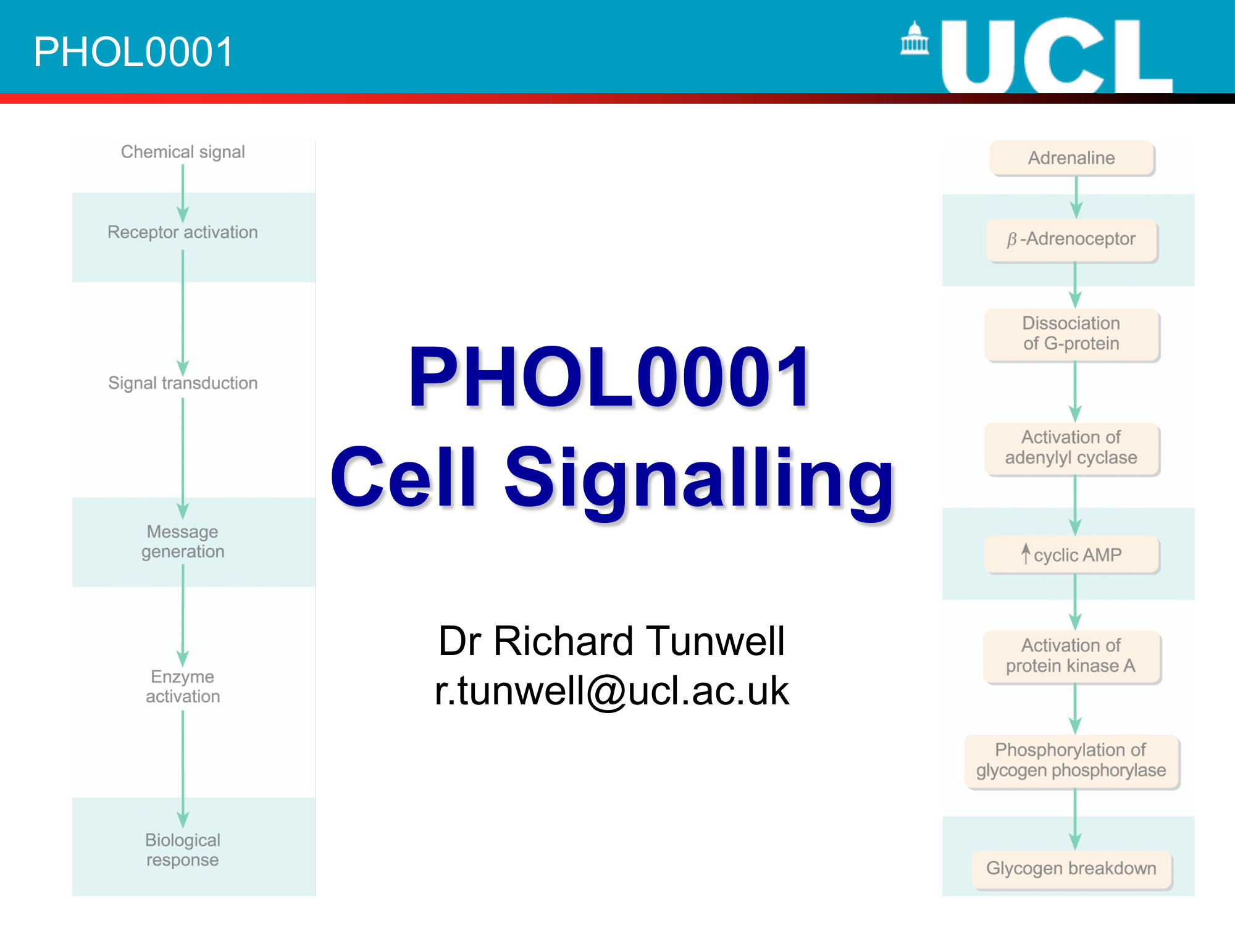
Cell Signalling
Dr Jigisha Patel
Jigisha.a.patel@ucl.ac.uk

Slide 2
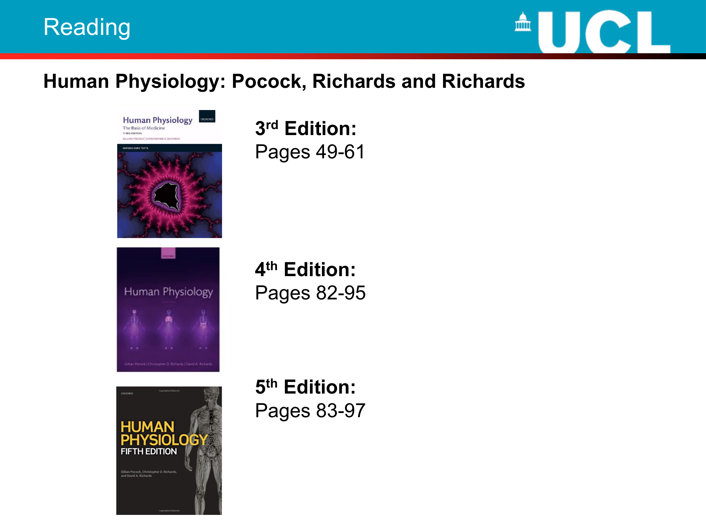

Slide 3
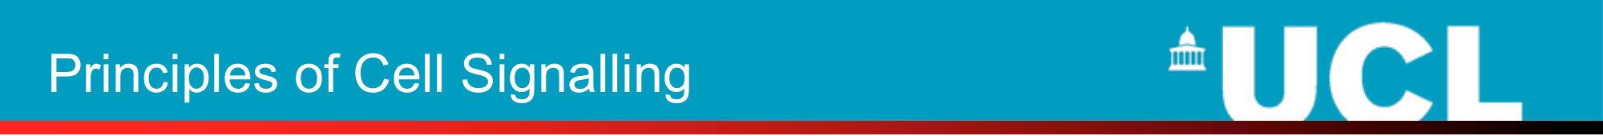
This topic will discuss:
The main types of signalling between cells
– paracrine, endocrine and synaptic signalling
How cells detect chemical signals
How cells respond to various chemical signals
– Changes in ion channel activity
– Second messenger cascades
– The control of gene expression

Slide 4
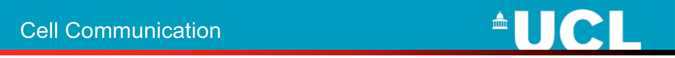
Cells communicate with each other in three ways:
• By diffusible chemical signals
• By direct surface contact between adjacent cells
• By direct cytoplasmic contact between adjacent cells via gap junctions
This lecture will focus on signalling by diffusible chemical agents

Slide 5
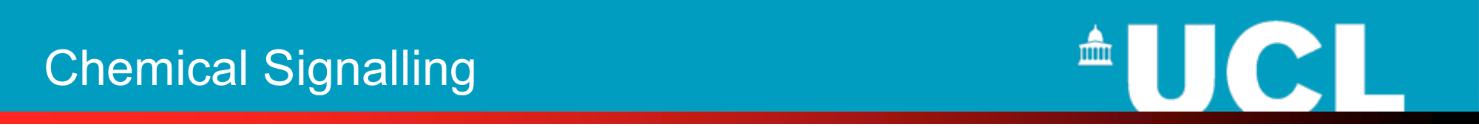
Cells use chemical signals in three ways:
• For localised signalling
– autocrine and paracrine signalling
• For generalized signalling to sites remote from the site of secretion
– endocrine signalling
• As neurotransmitters in synaptic signalling
– provides discrete signalling between nerves and their target tissues

Slide 6
FORMS OF CELL SIGNALLING
There are four basic categories of chemical signaling found in multicellular organisms:
paracrine signaling
autocrine signaling
endocrine signaling
signaling through cell-cell contact
The main difference between the different categories of signaling is the distance that the signal travels through the organism to reach the target cell.

Slide 7
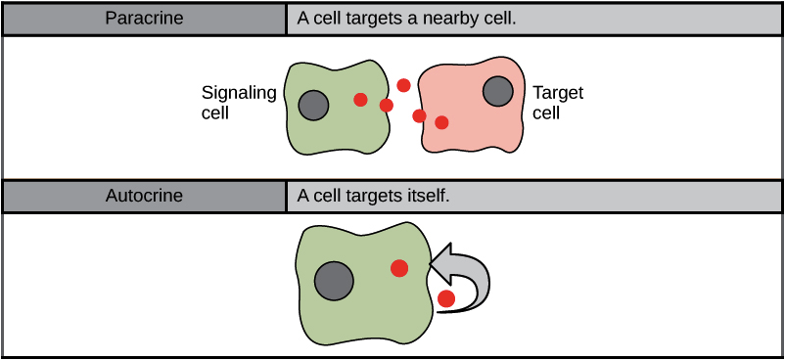
PARACRINE SIGNALING
cells communicate over relatively short distances
allows cells to locally coordinate activities with their neighbors
important during development
  they allow one group of cells to tell a neighboring group of cells what cellular identity to take on

Slide 8
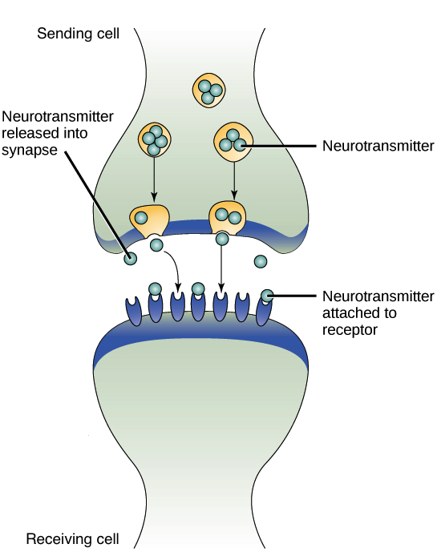
EXAMPLE OF PARACRINE SIGNALING
SYNAPTIC SIGNALING
  Nerve cells transmit signals
  This process is named for the synapse, the junction between two nerve cells where signal transmission occurs

Slide 9
AUTOCRINE SIGNALING
a cell signals to itself, releasing a ligand that binds to receptors on its own surface
important during development
  helping cells take on and reinforce their correct identities
  play a key role in metastasis
Ex: Cytokines/Immune Cells, Growth Factors

Slide 10
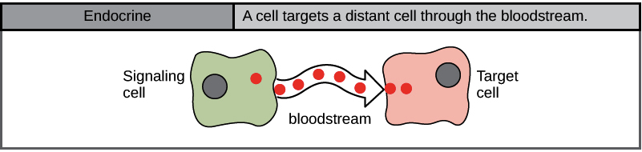
ENDOCRINE SIGNALING
cells transmit signals over long distances
  often use the circulatory system as a distribution network for the messages they send
signals are produced by specialized cells and released into the bloodstream, which carries them to target cells in distant parts of the body
signals are produced in one part of the body and travel through the circulation to reach far-away targets are known as hormones.

Slide 11
ENDOCRINE SIGNALING
In humans, endocrine glands release hormones:
Thyroid
Hypothalamus
Pituitary
Gonads (testes and ovaries)
Pancreas

Slide 12
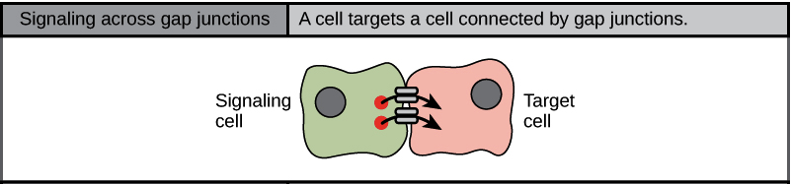
SIGNALING THROUGH CELL-CELL CONTACT
Gap junctions in animals are tiny channels that directly connect neighboring cells.
These water-filled channels allow small signaling molecules, called intracellular mediators, to diffuse between the two cells.
small molecules and ions are able to move between cells
large molecules like proteins and DNA cannot fit through the channels without special assistance.

Slide 13
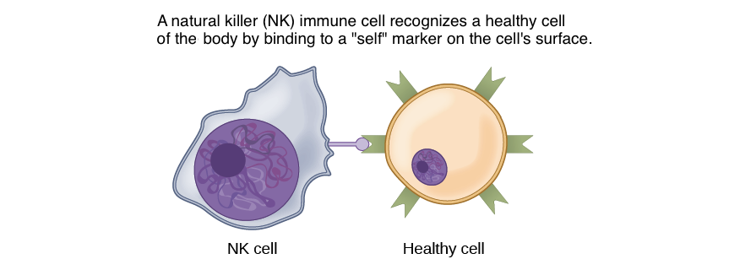
SIGNALING THROUGH CELL-CELL CONTACT
Two cells may bind to one another because they carry complementary proteins on their surfaces. When the proteins bind to one another, this interaction changes the shape of one or both proteins, transmitting a signal.
This kind of signaling is especially important in the immune system, where immune cells use cell-surface markers to recognize “self” cells (the body's own cells) and cells infected by pathogens.

Slide 14
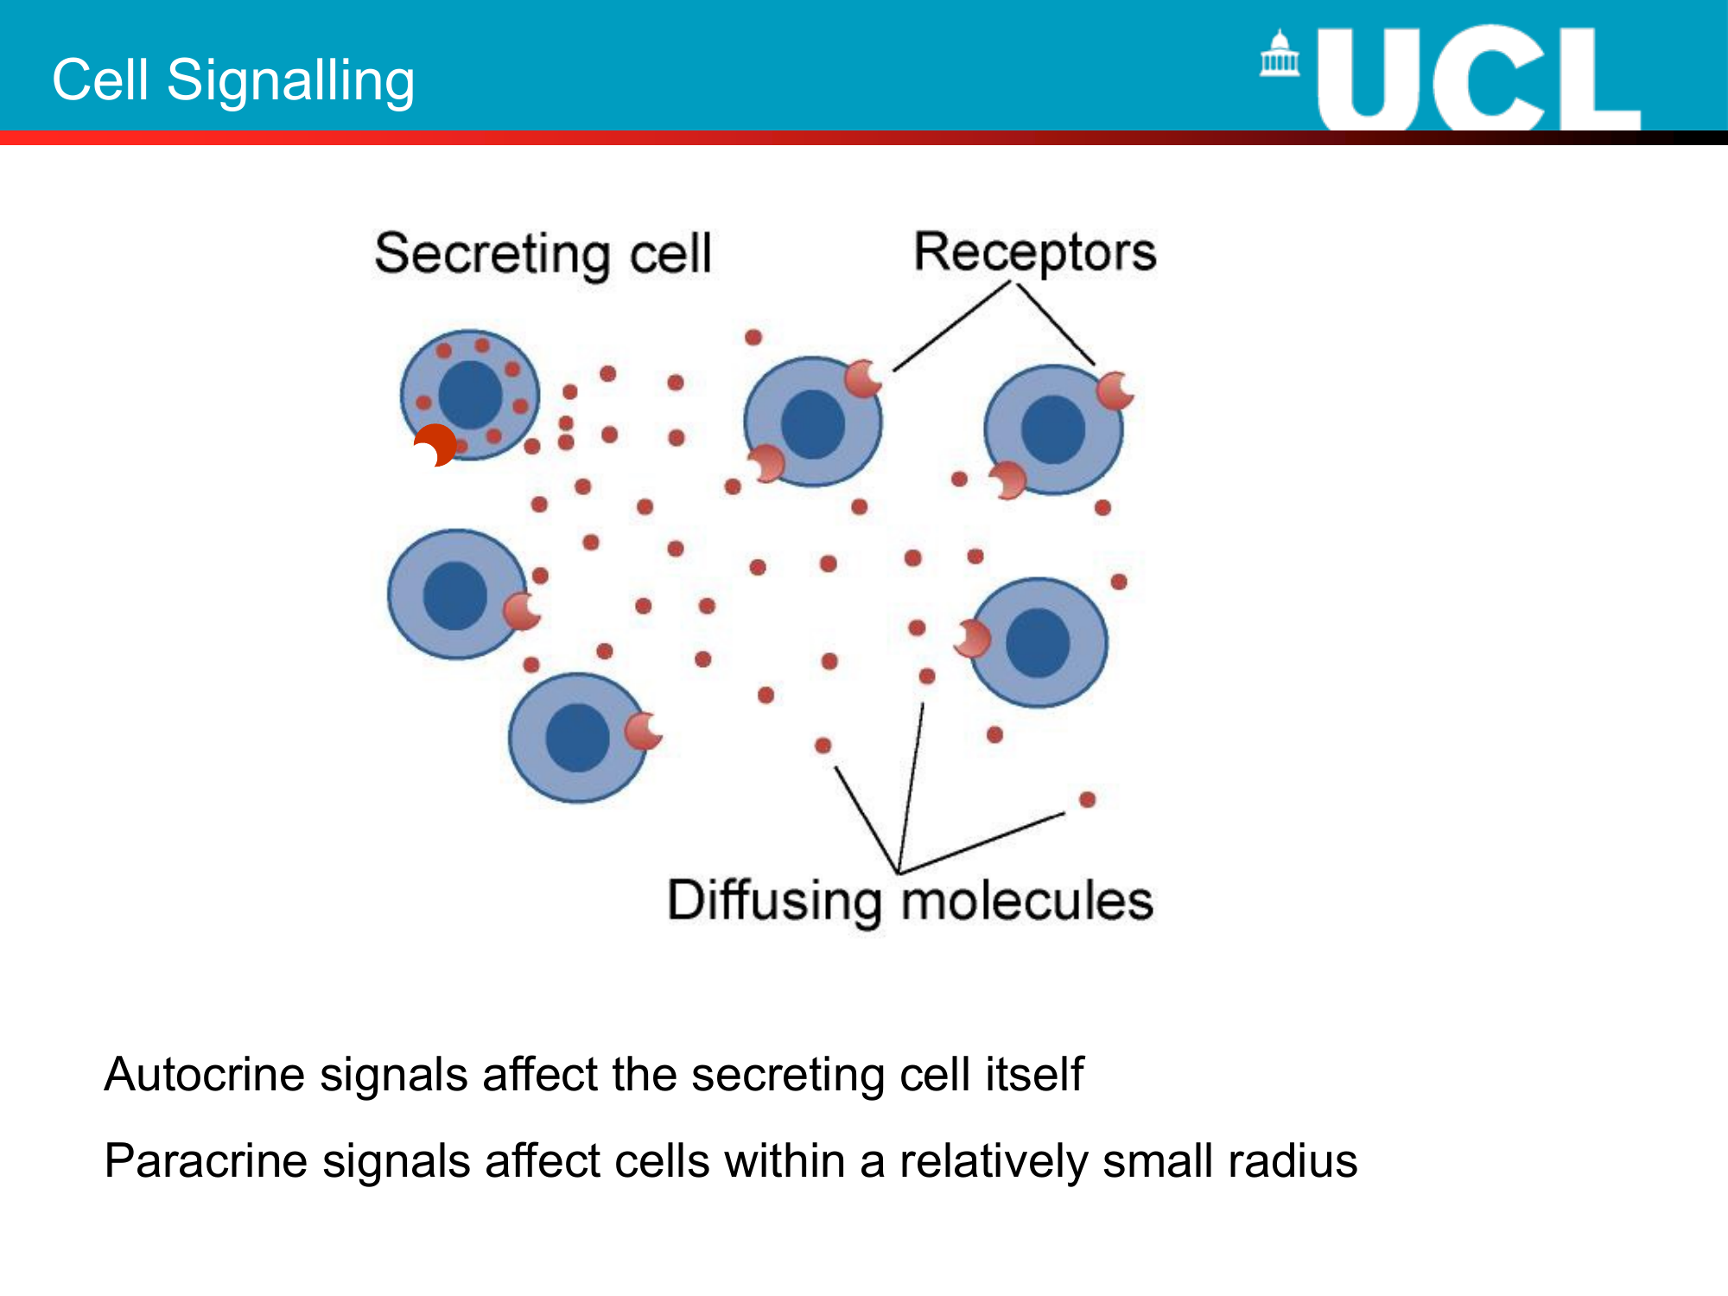

Slide 15
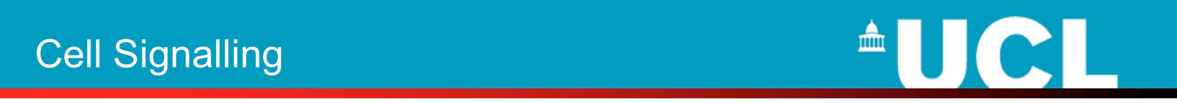
Chemical signals secreted into the blood to act on distant target cells are called HORMONES.
• Hormone comes from the Greek ὁρμή meaning "impetus”
• Hormones are often secreted by specialised glands called the endocrine glands
• Since hormones are distributed throughout the body via the circulation, their target cells must possess specific receptors that enable them to recognise the signals intended for them
• The difference between endocrine and paracrine signals reflects the quantity of the chemical secreted

Slide 16
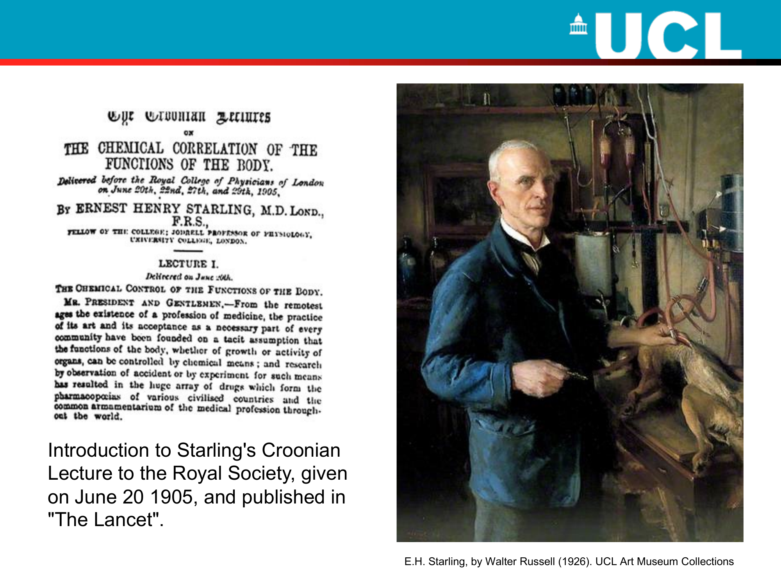

Slide 17
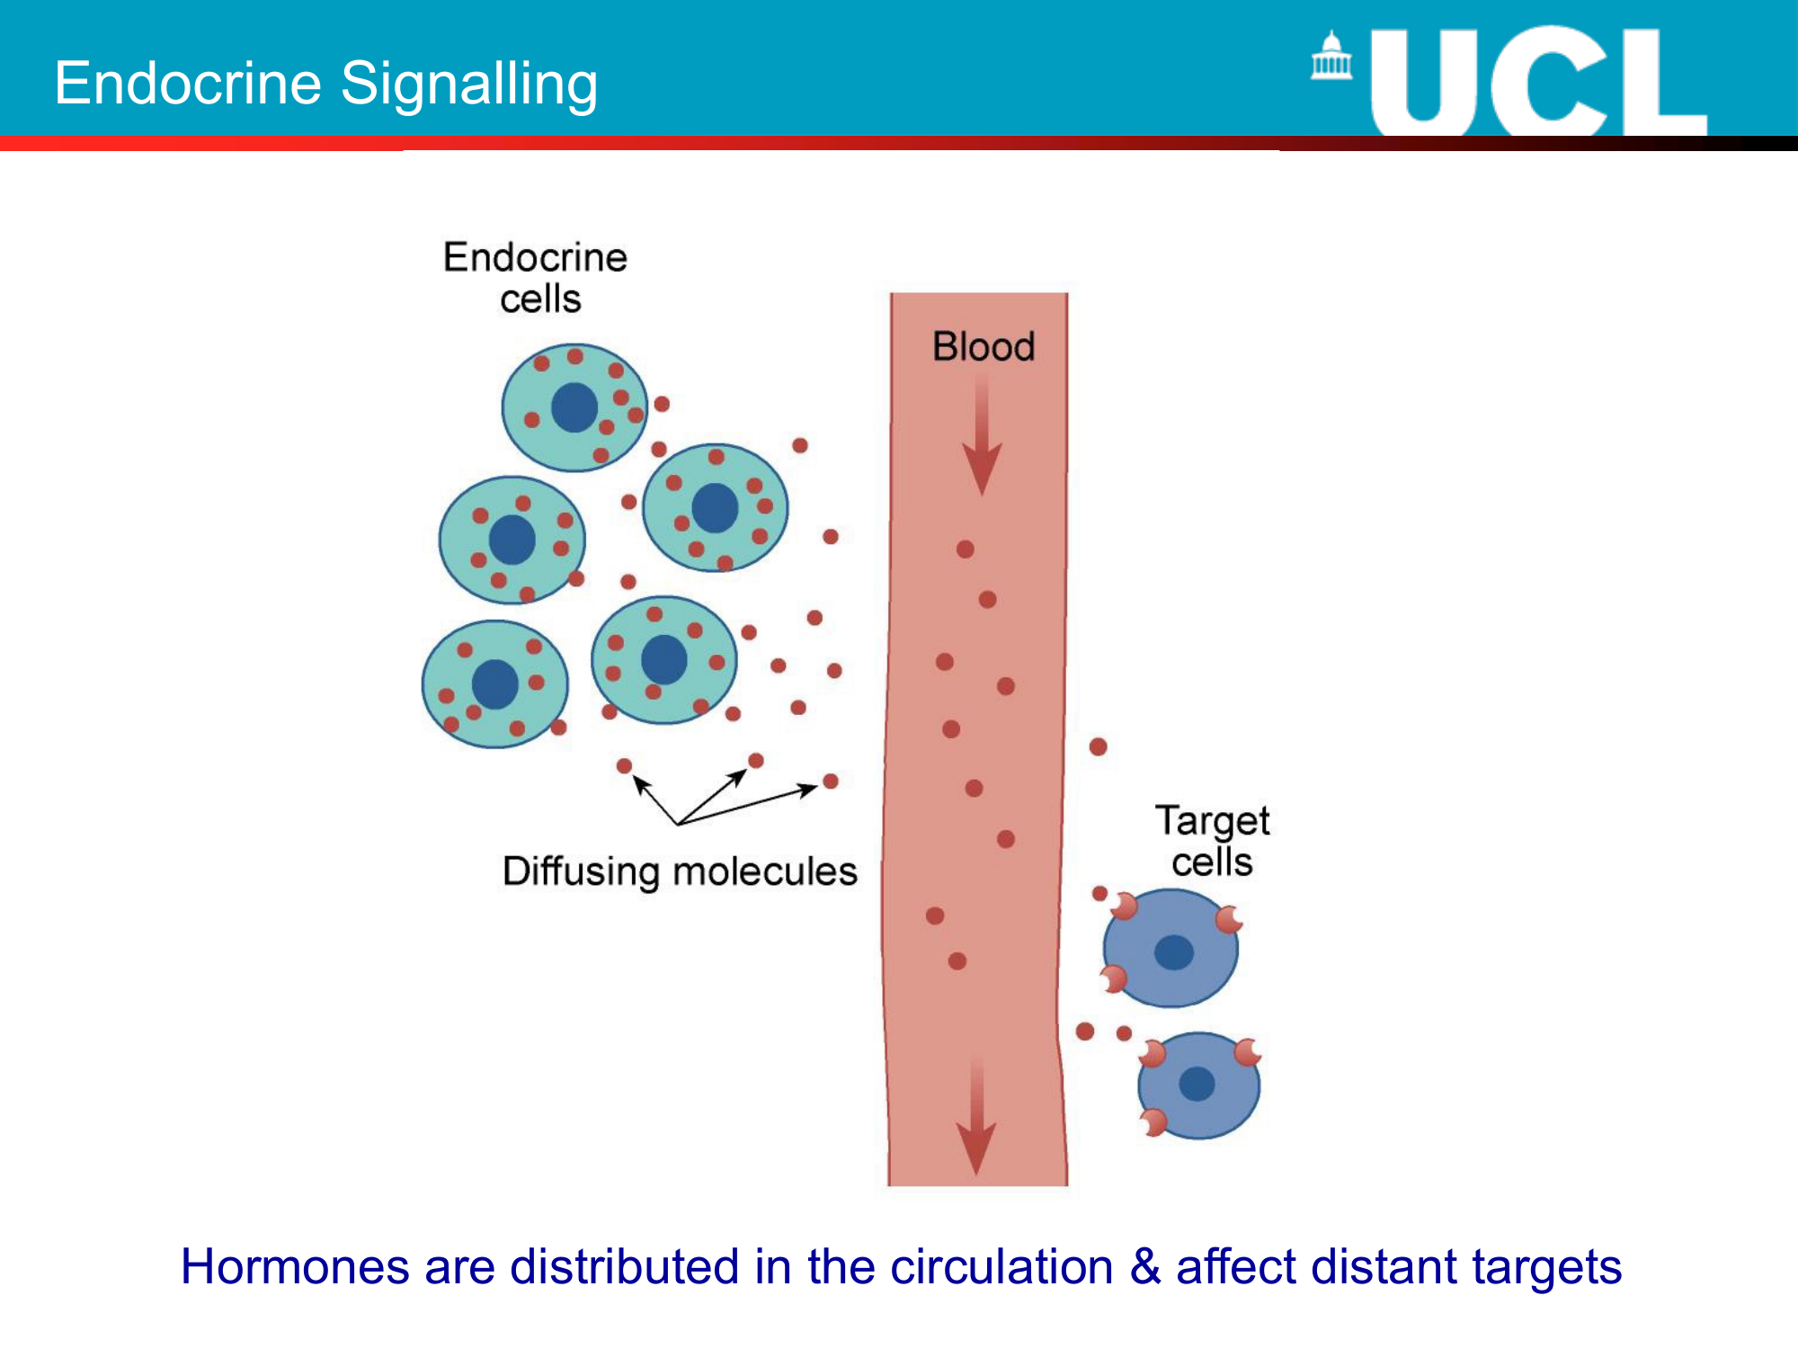

Slide 18
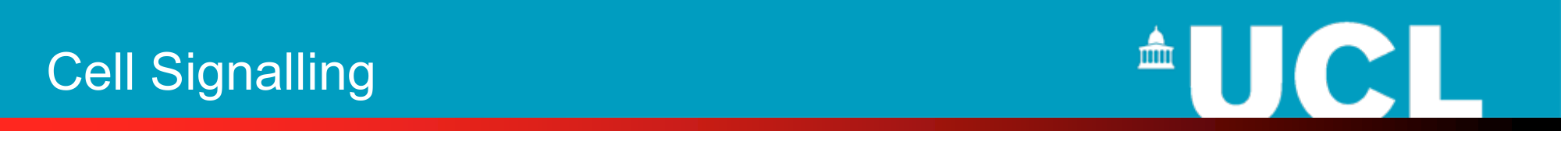
Hormones are suitable for regulating the activity of a variety of cell types.
BUT
• Their effect cannot be restricted to an individual cell
• The speed of signalling is relatively slow
These problems are overcome by nerve cells which are adapted for fast and specific activation of individual cells or groups of cells e.g. muscle cells.
The kind of signalling employed by nerve cells is known as synaptic signalling. Nerve cells permit fast signalling over long distances.

Slide 19
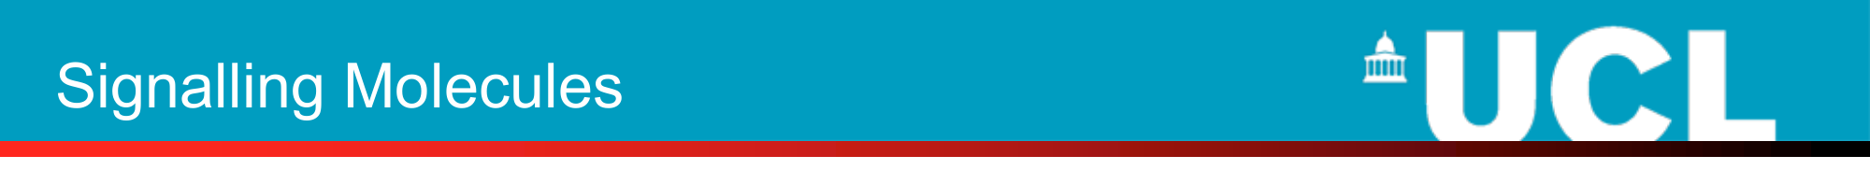
The nature of signalling molecules:
• Signalling molecules are very diverse in structure
• Cells may use hydrophillic or hydrophobic molecules for signalling
• Some signalling molecules have a very small molecular mass e.g. nitric oxide
• Others are very large e.g. growth hormone

Slide 20
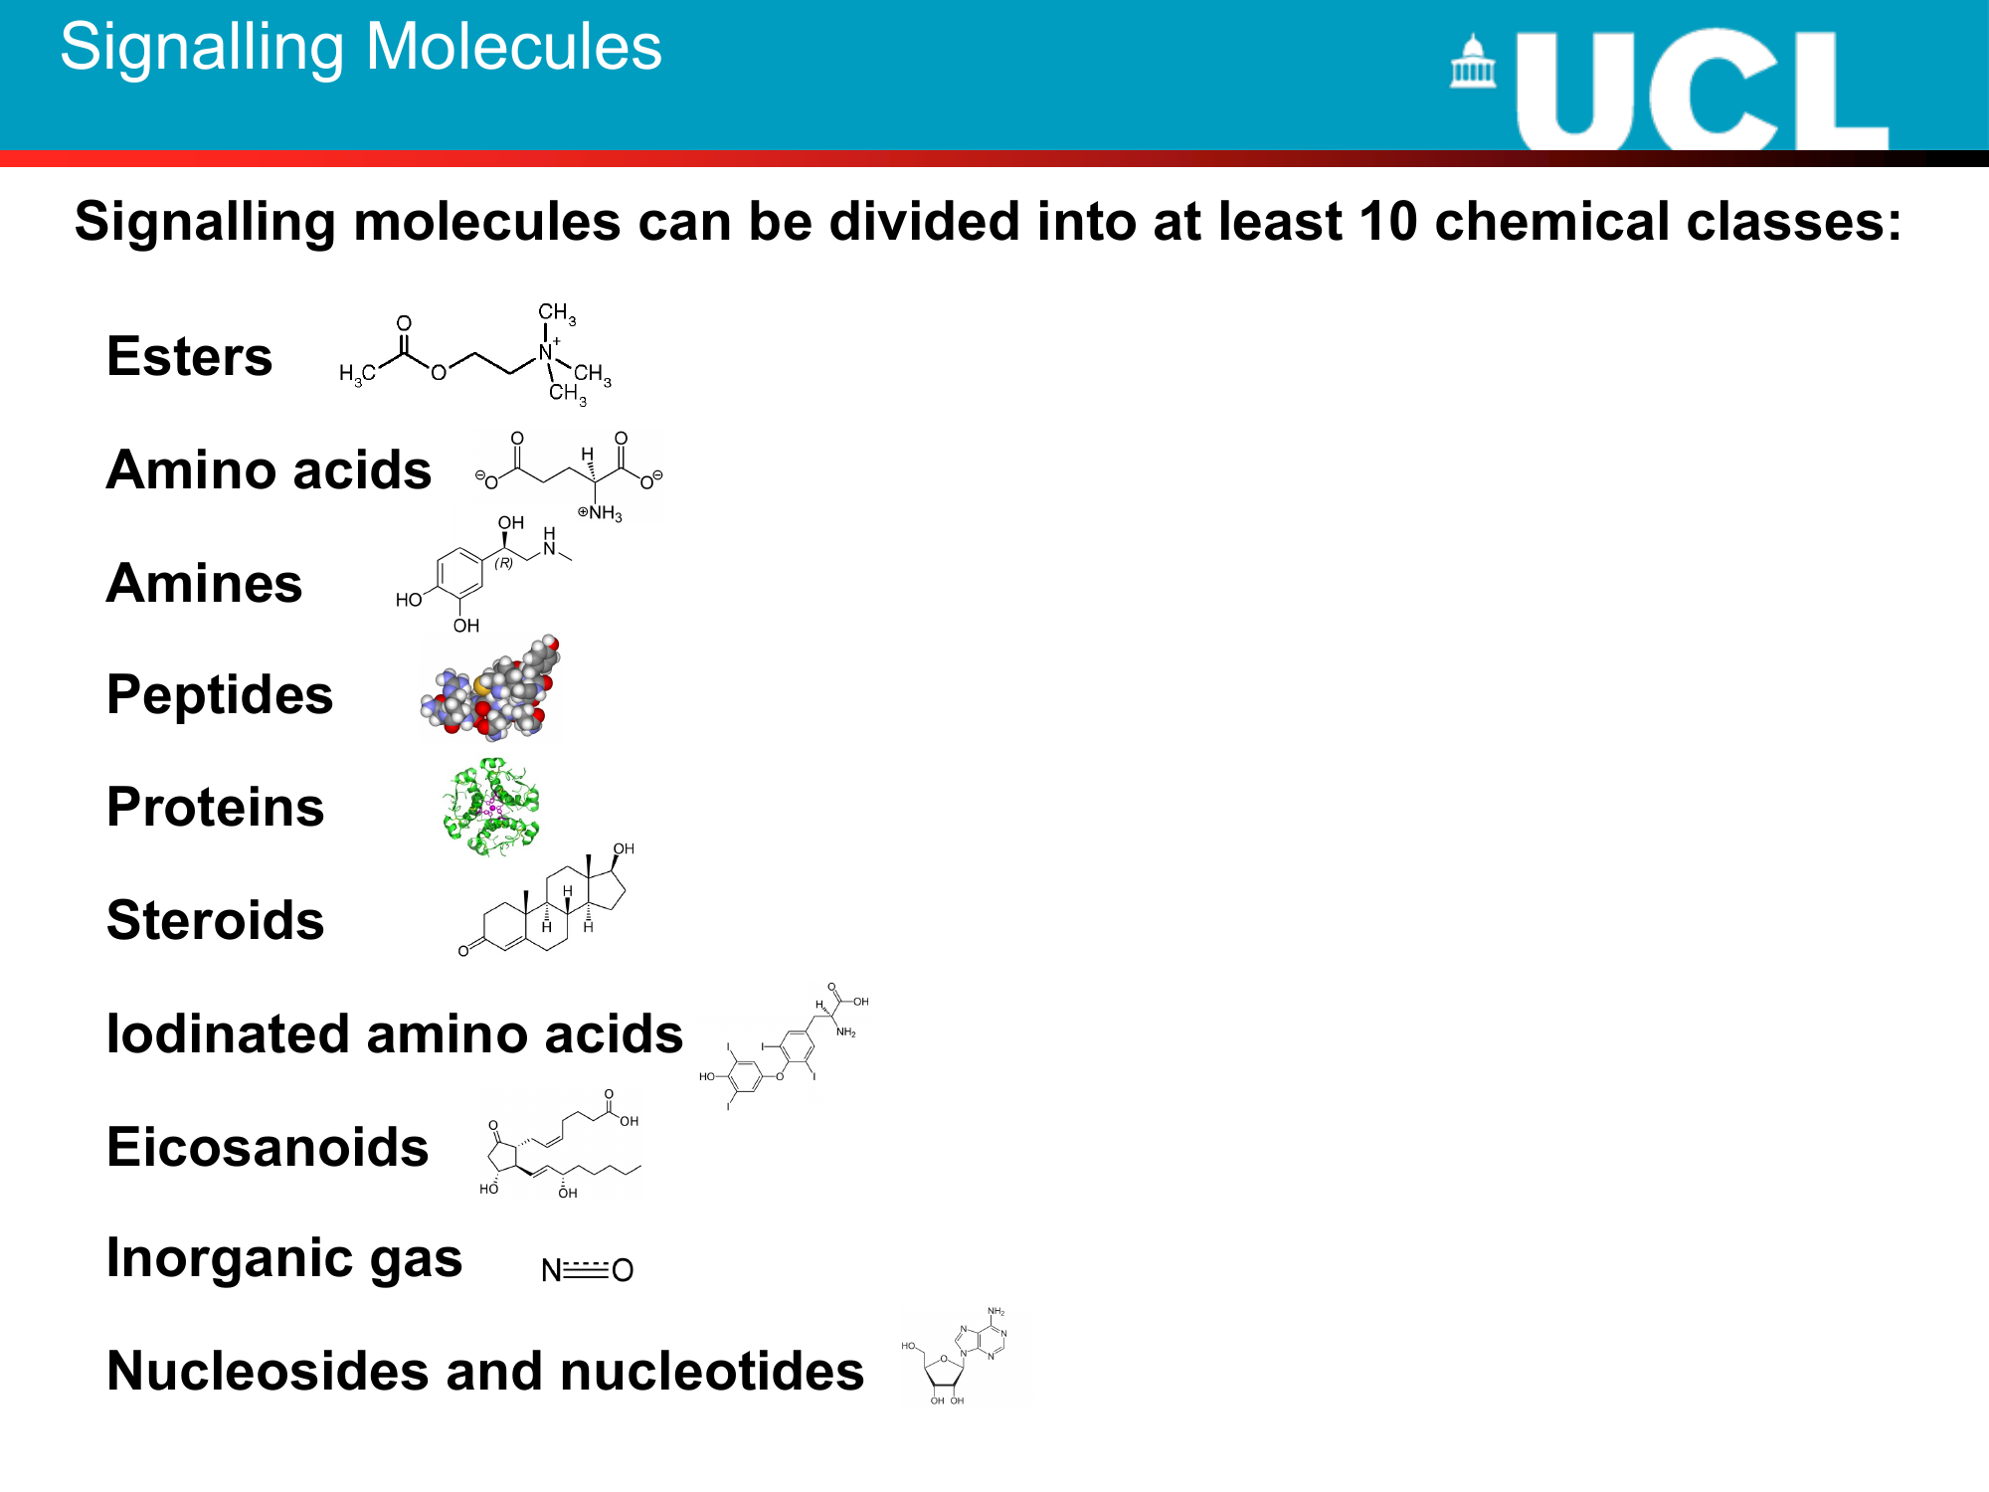

Slide 21
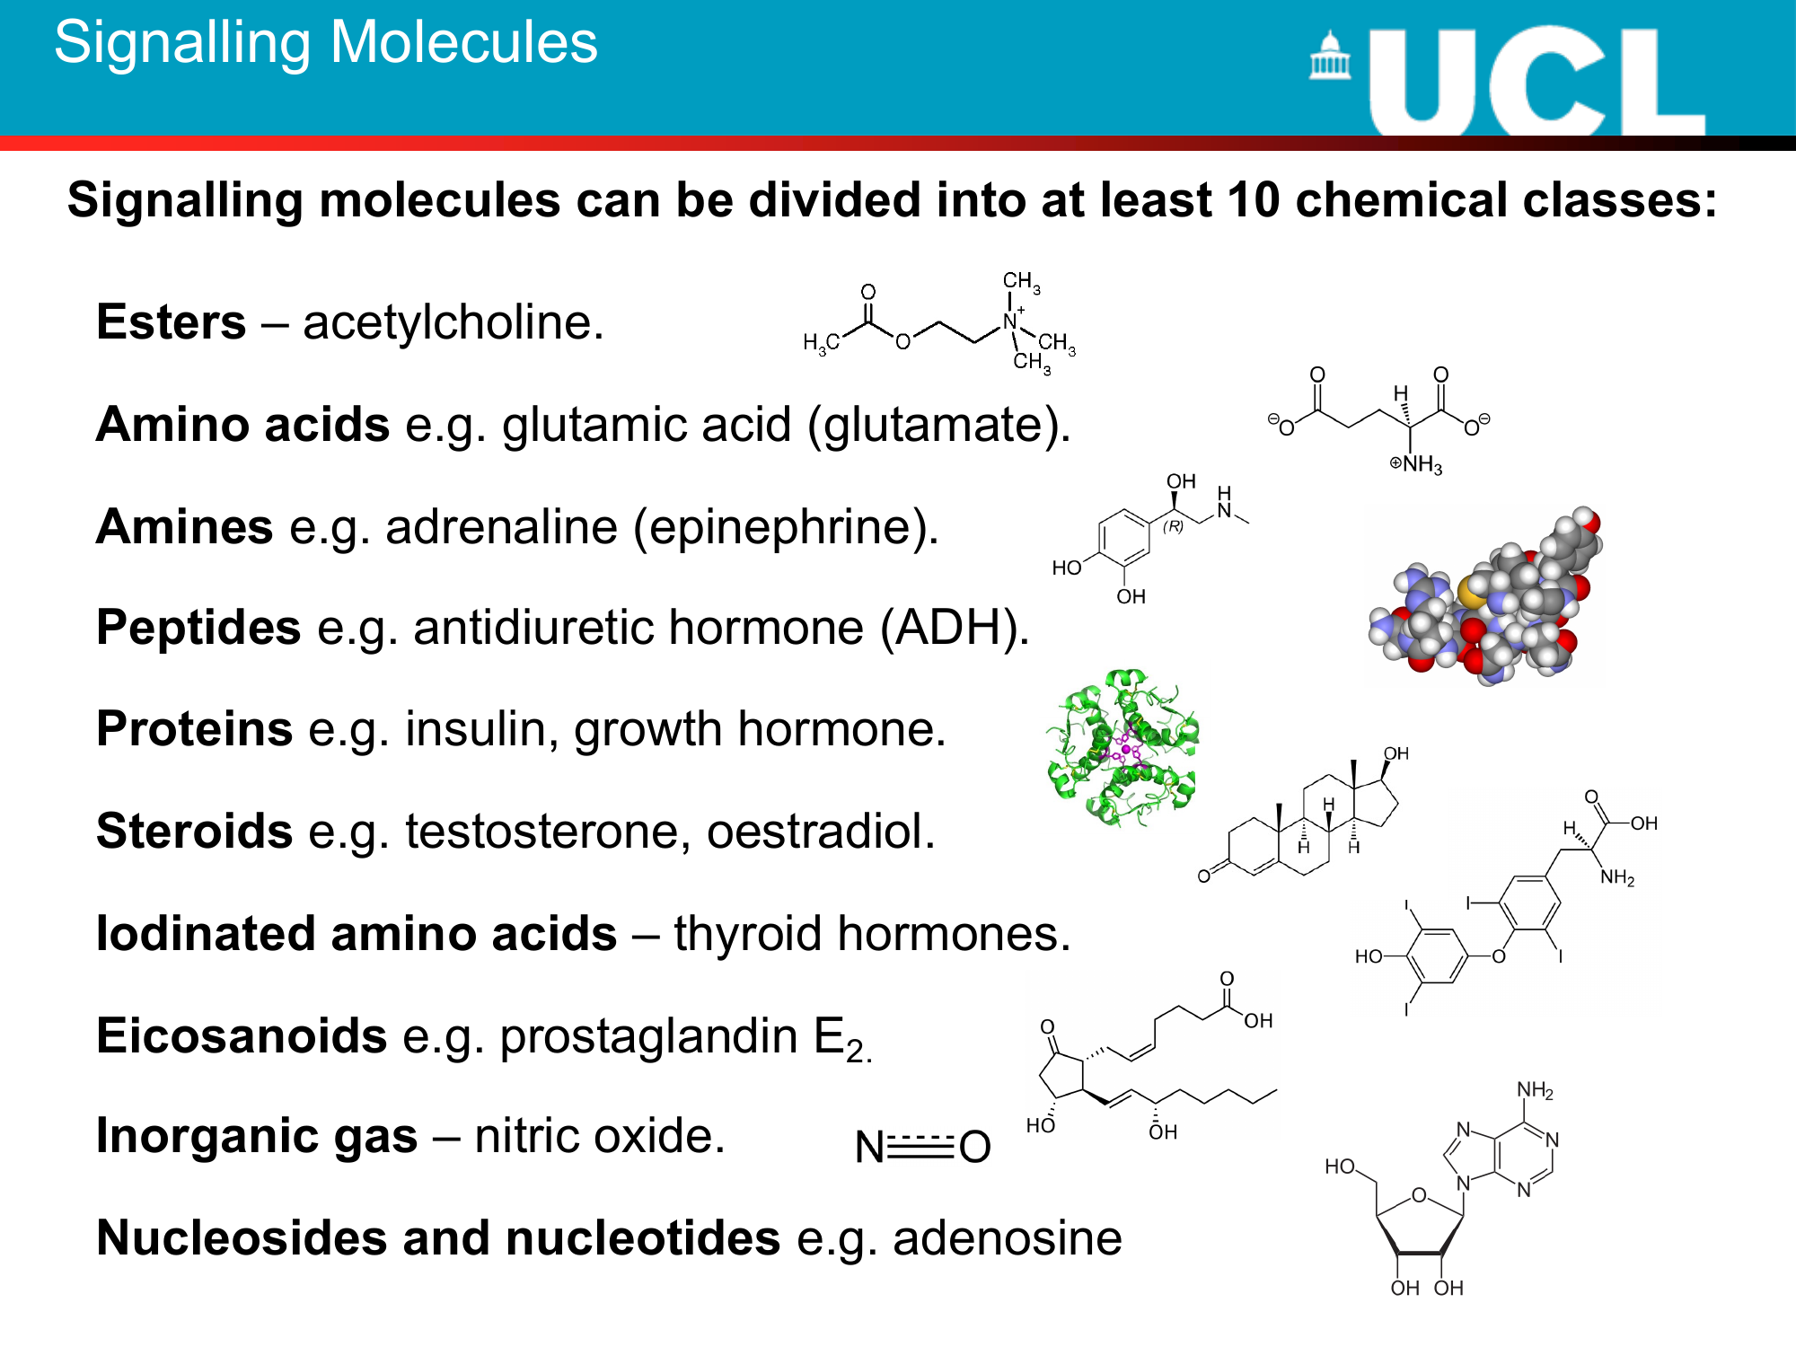

Slide 22
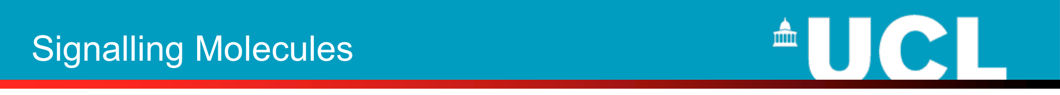
Chemical signals are detected by specific receptor molecules:
• There are many different types of chemical signal being secreted at the same time
• Consequently, cells need to know which signals are intended for them
• To do this they have specific recognition molecules known as receptors
• Substances that activate a receptor are called agonists
• Substances that block the effects of an agonist are called antagonists

Slide 23
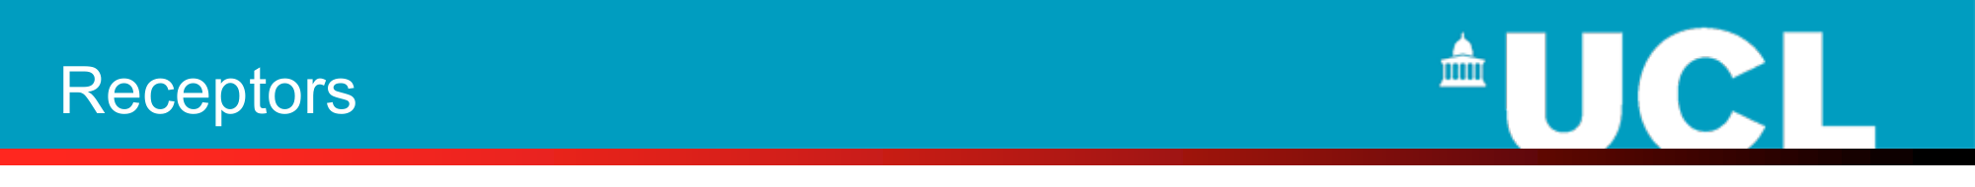
• All receptors are proteins
• Those that detect water soluble signals are located in the plasma membrane e.g. insulin receptors
• Hydrophobic signalling molecules cross the plasma membrane and bind to intracellular receptors e.g. oestrogen receptors
• Some intracellular organelles possess receptors for molecules generated within the cell e.g. endoplasmic receptors for inositol trisphosphate

Slide 24
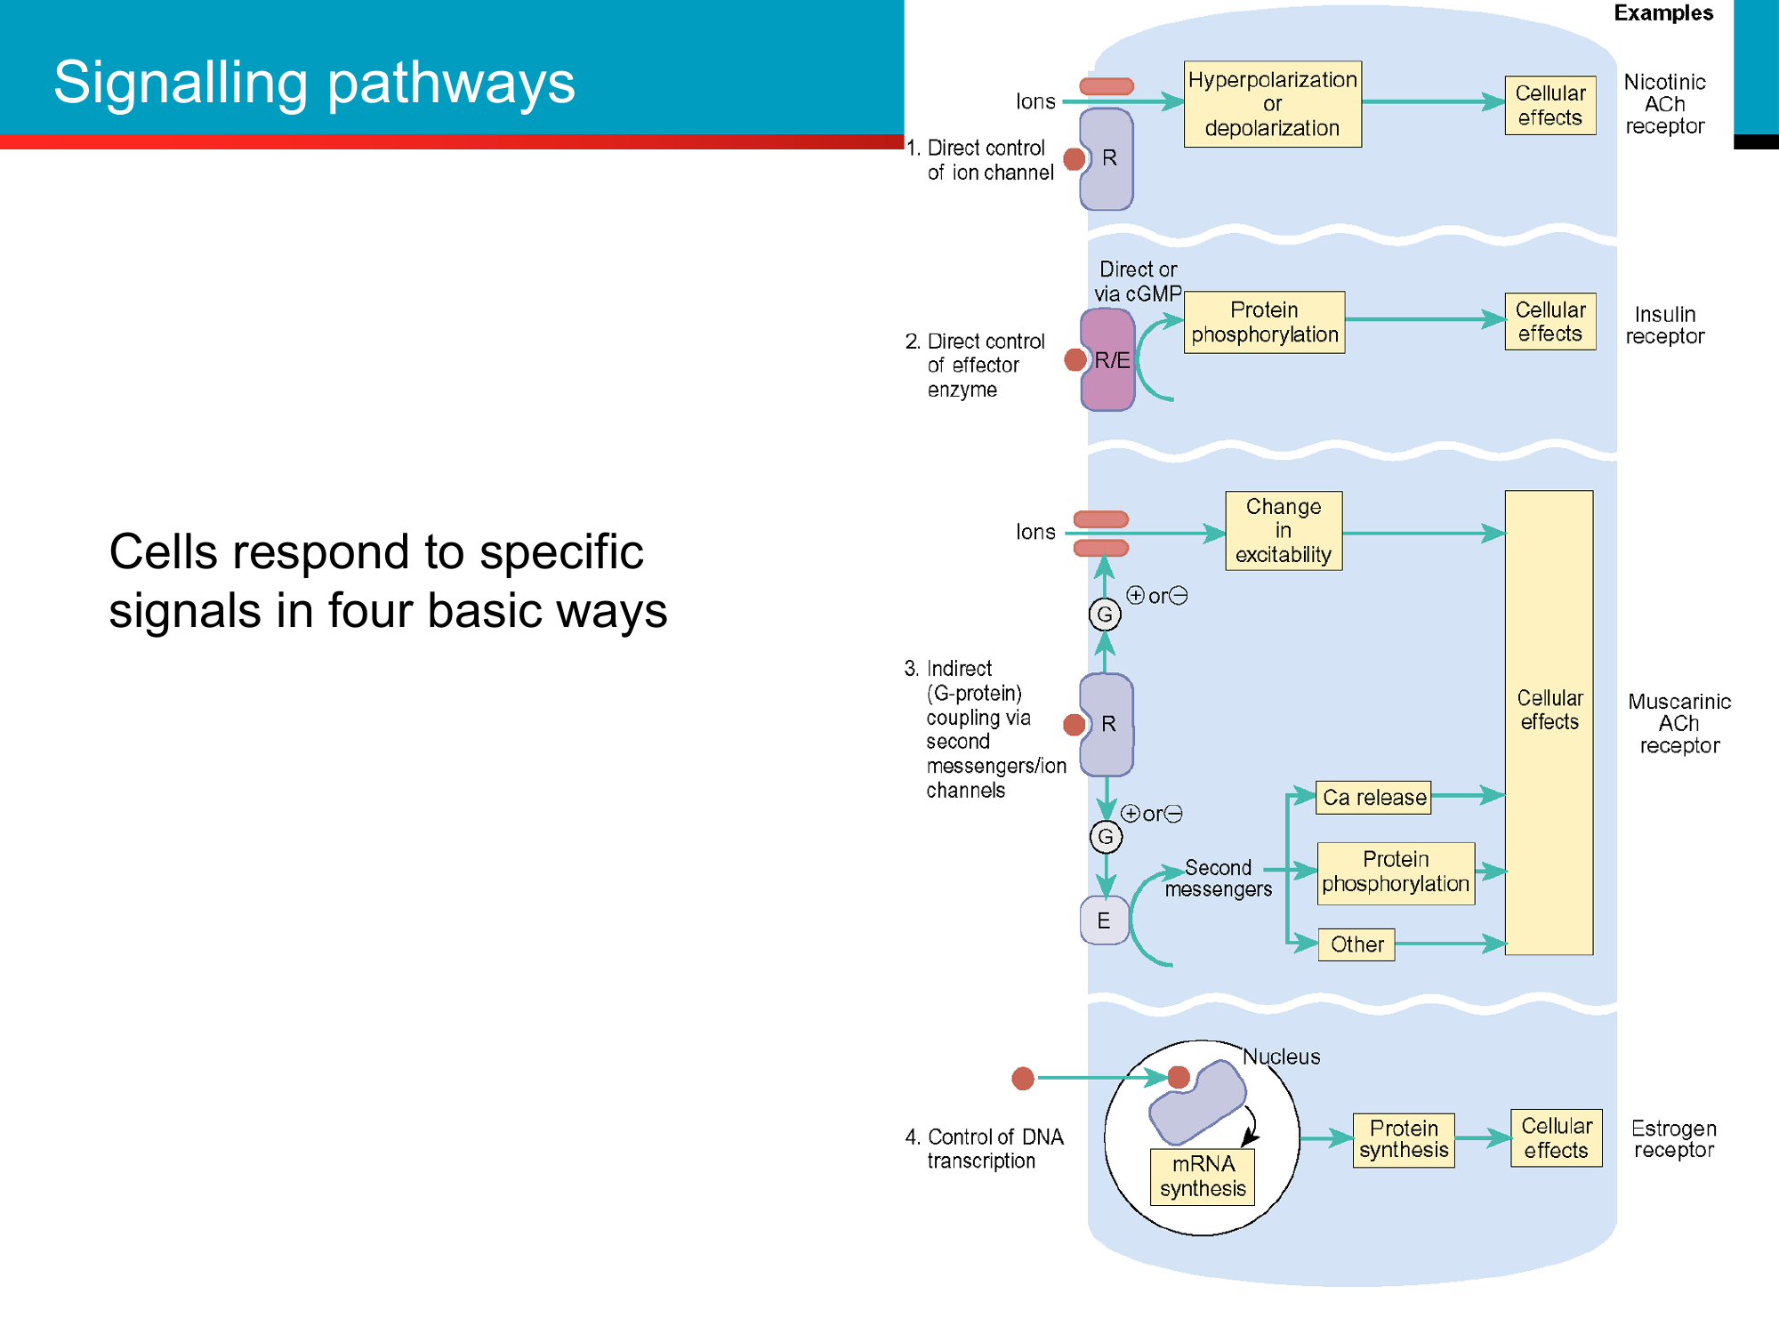

Slide 25
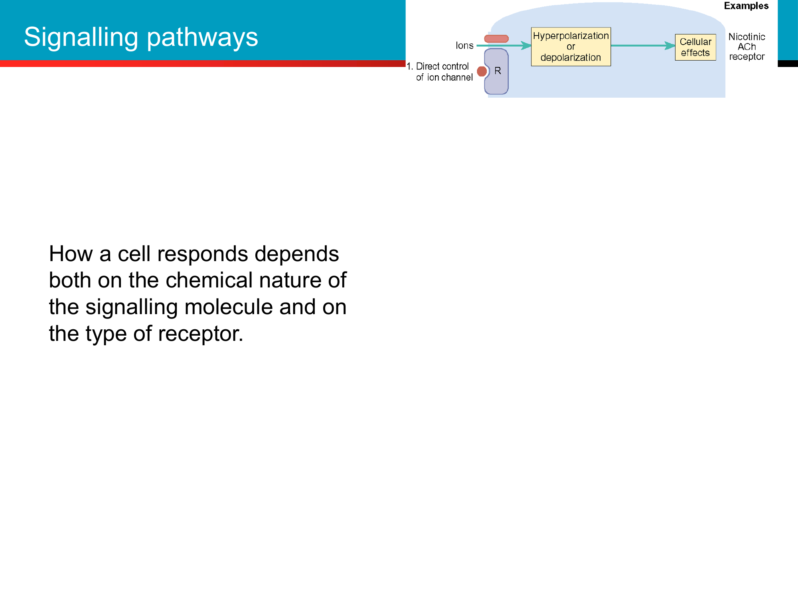

Slide 26
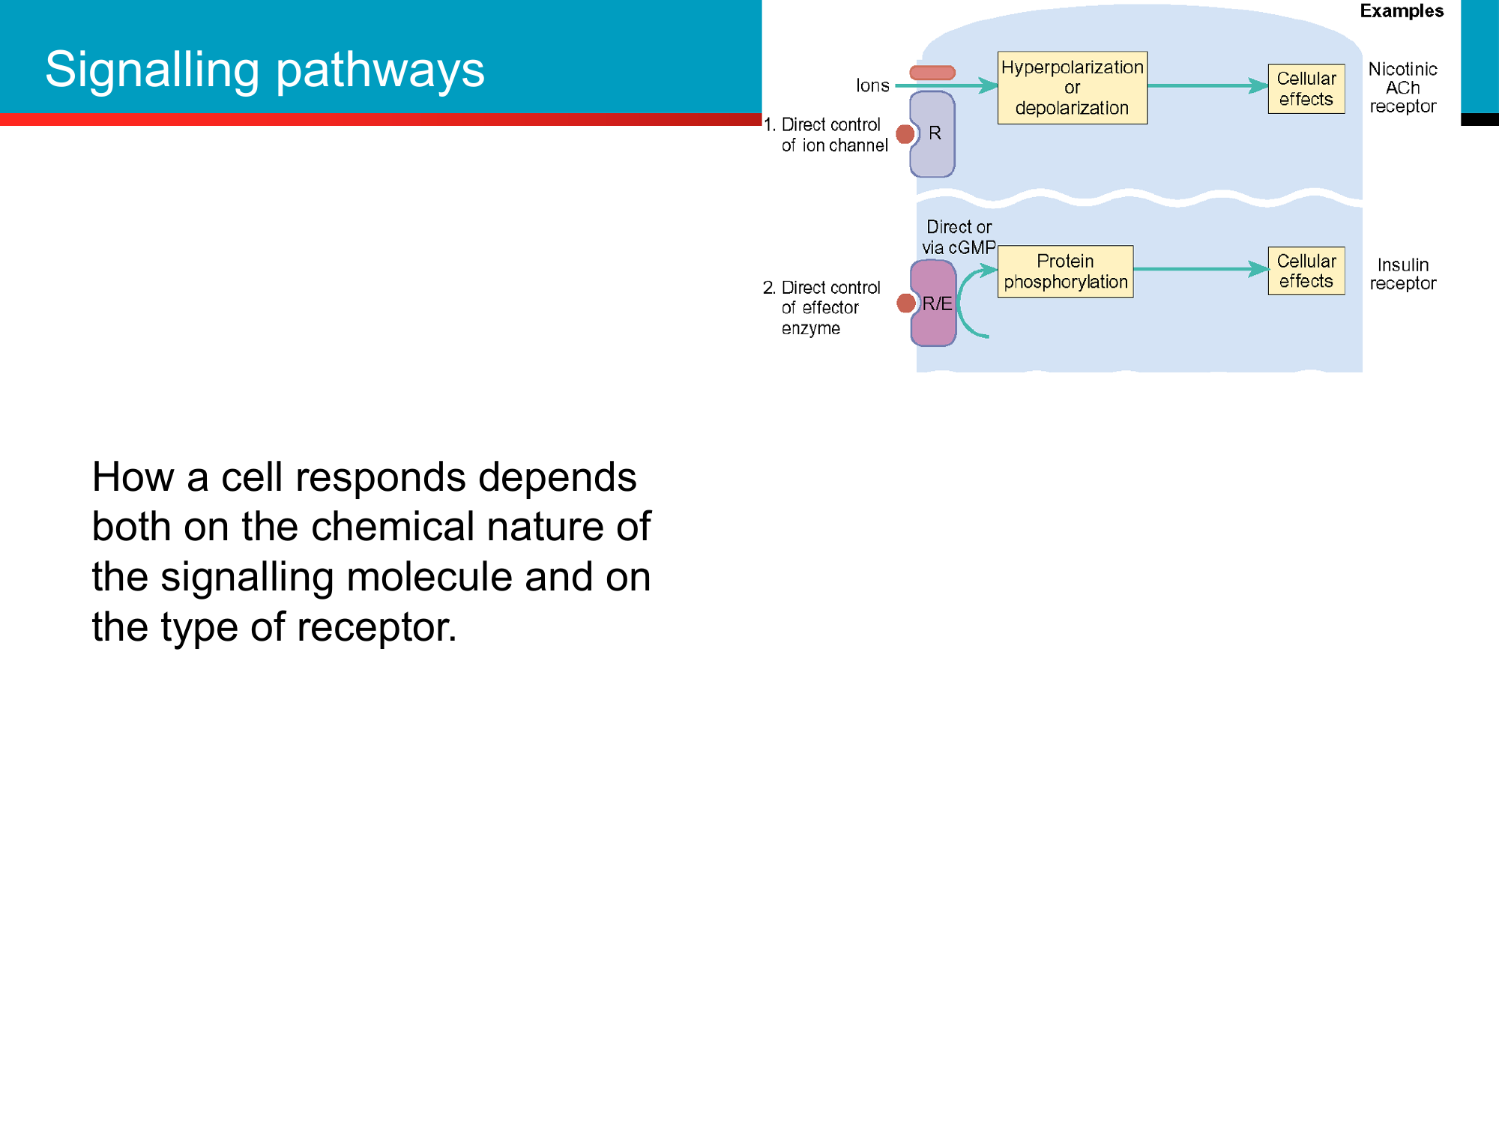

Slide 27
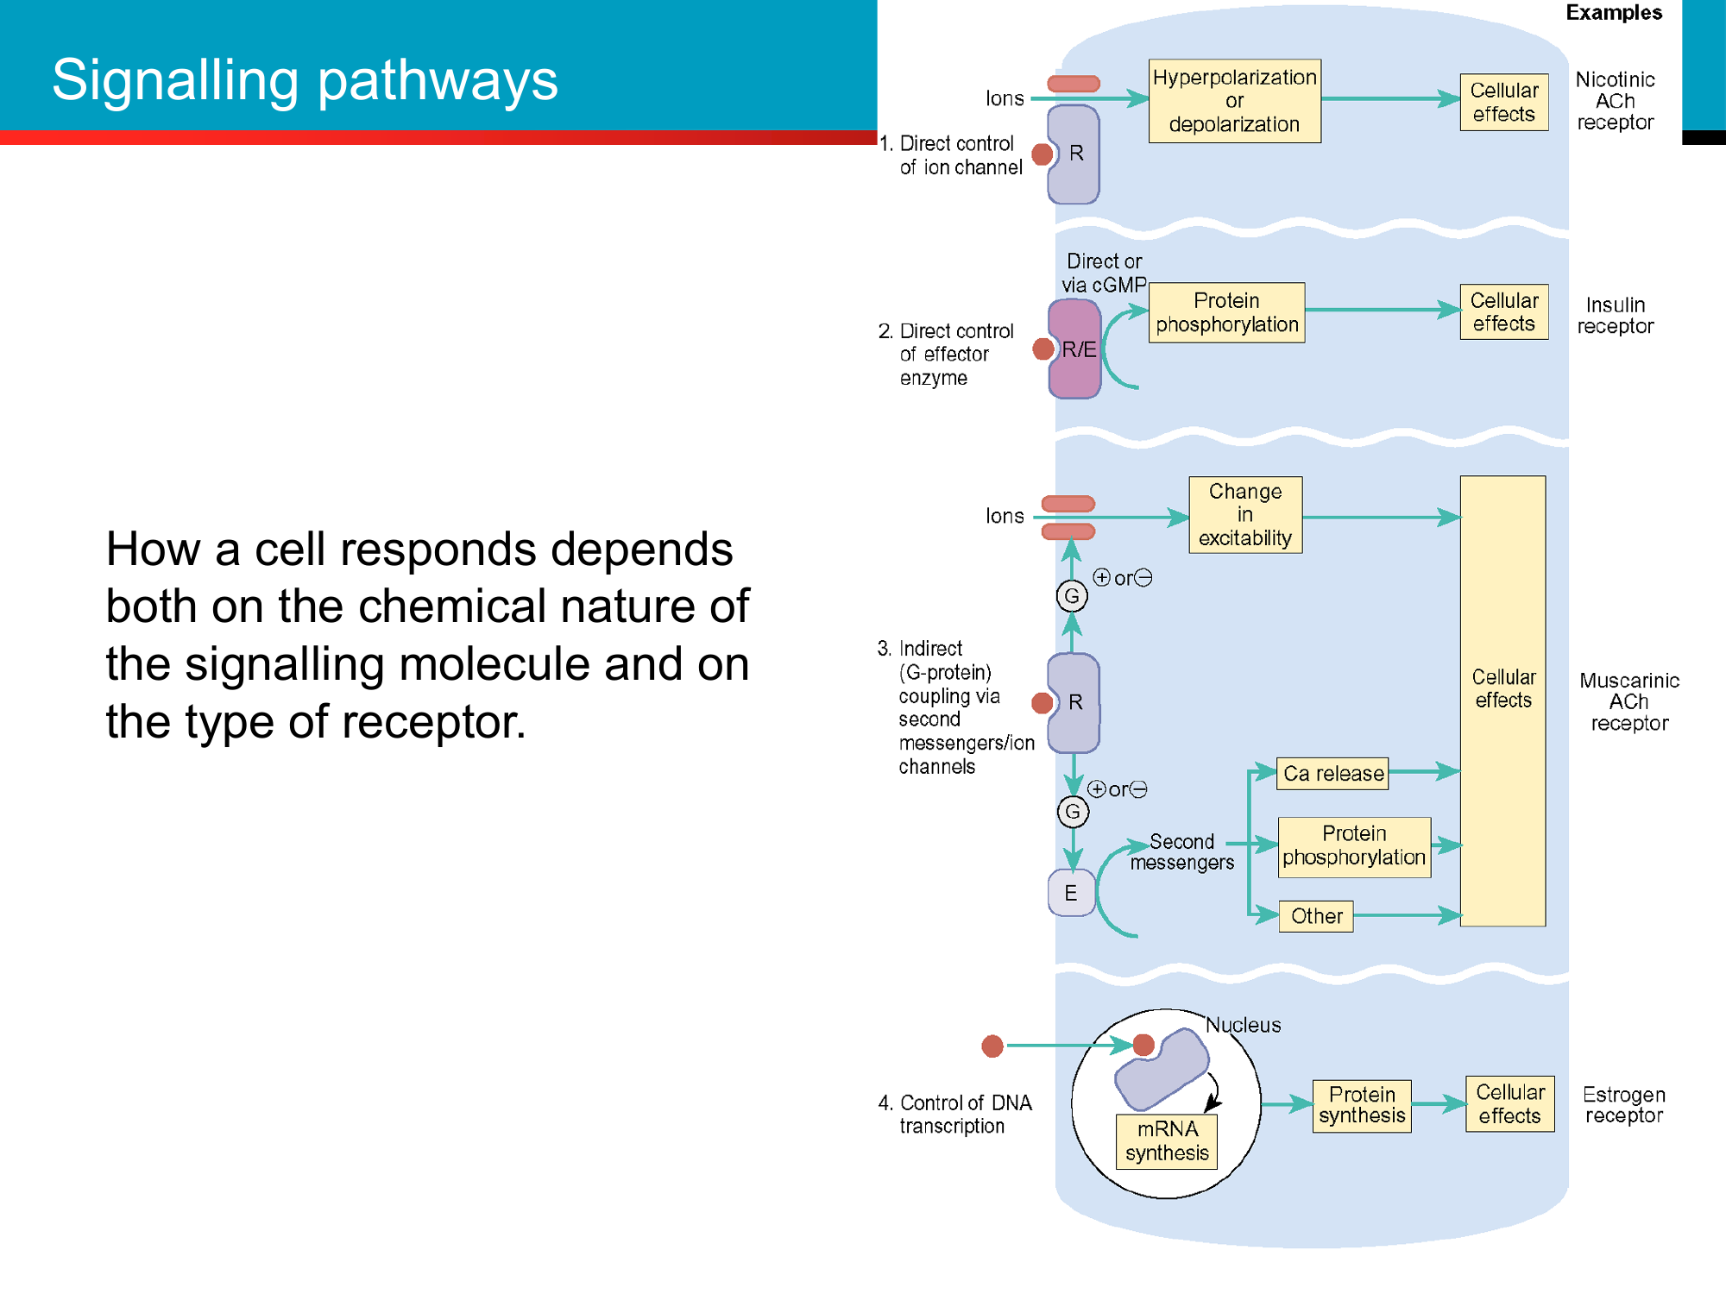

Slide 29
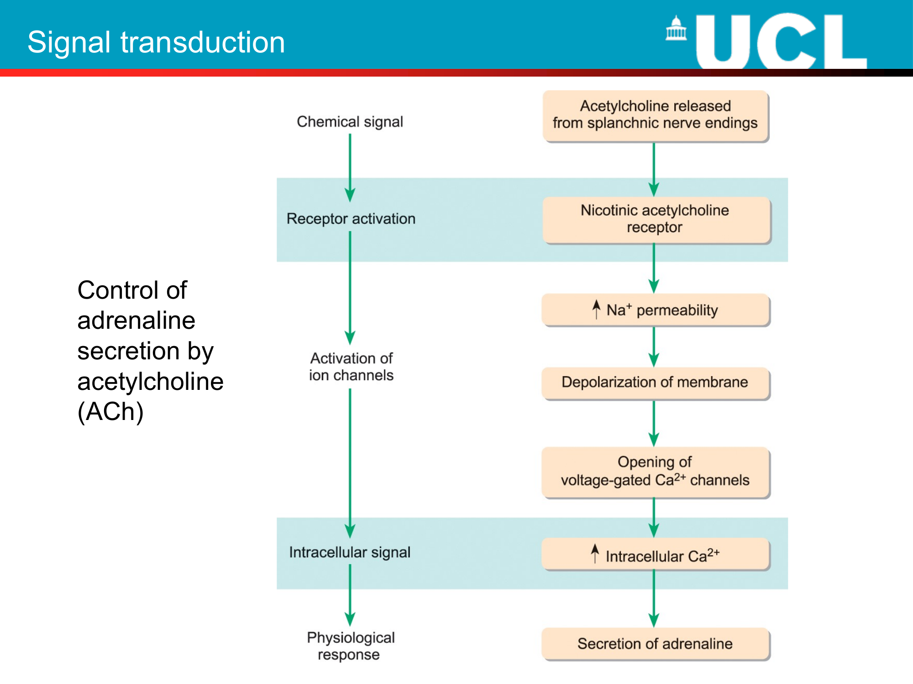

Slide 30
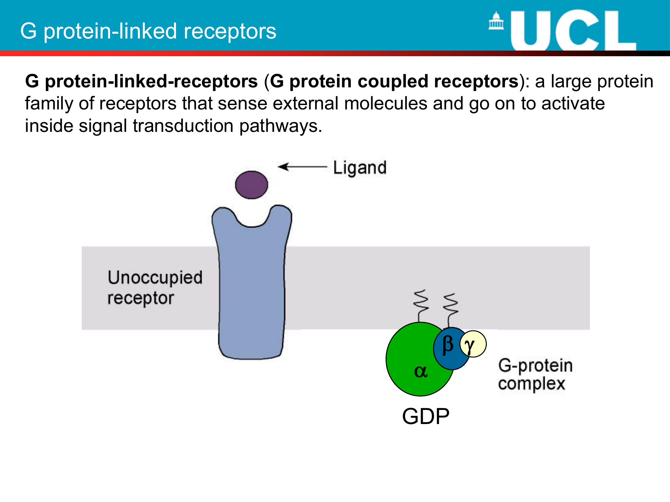
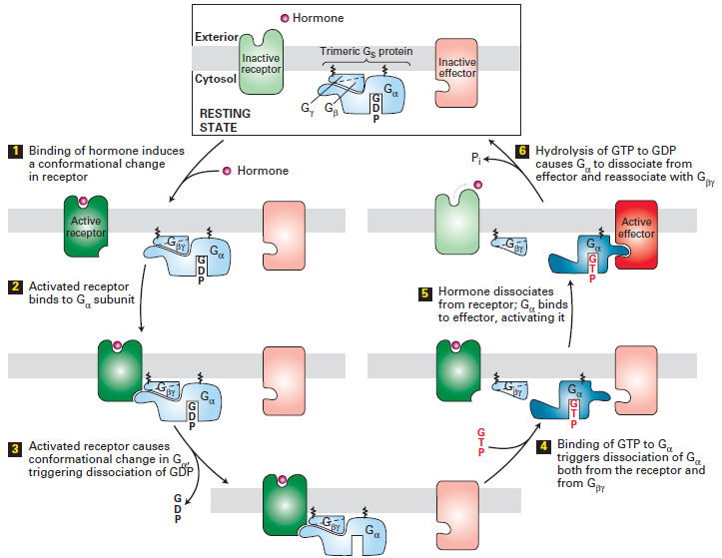

Slide 32
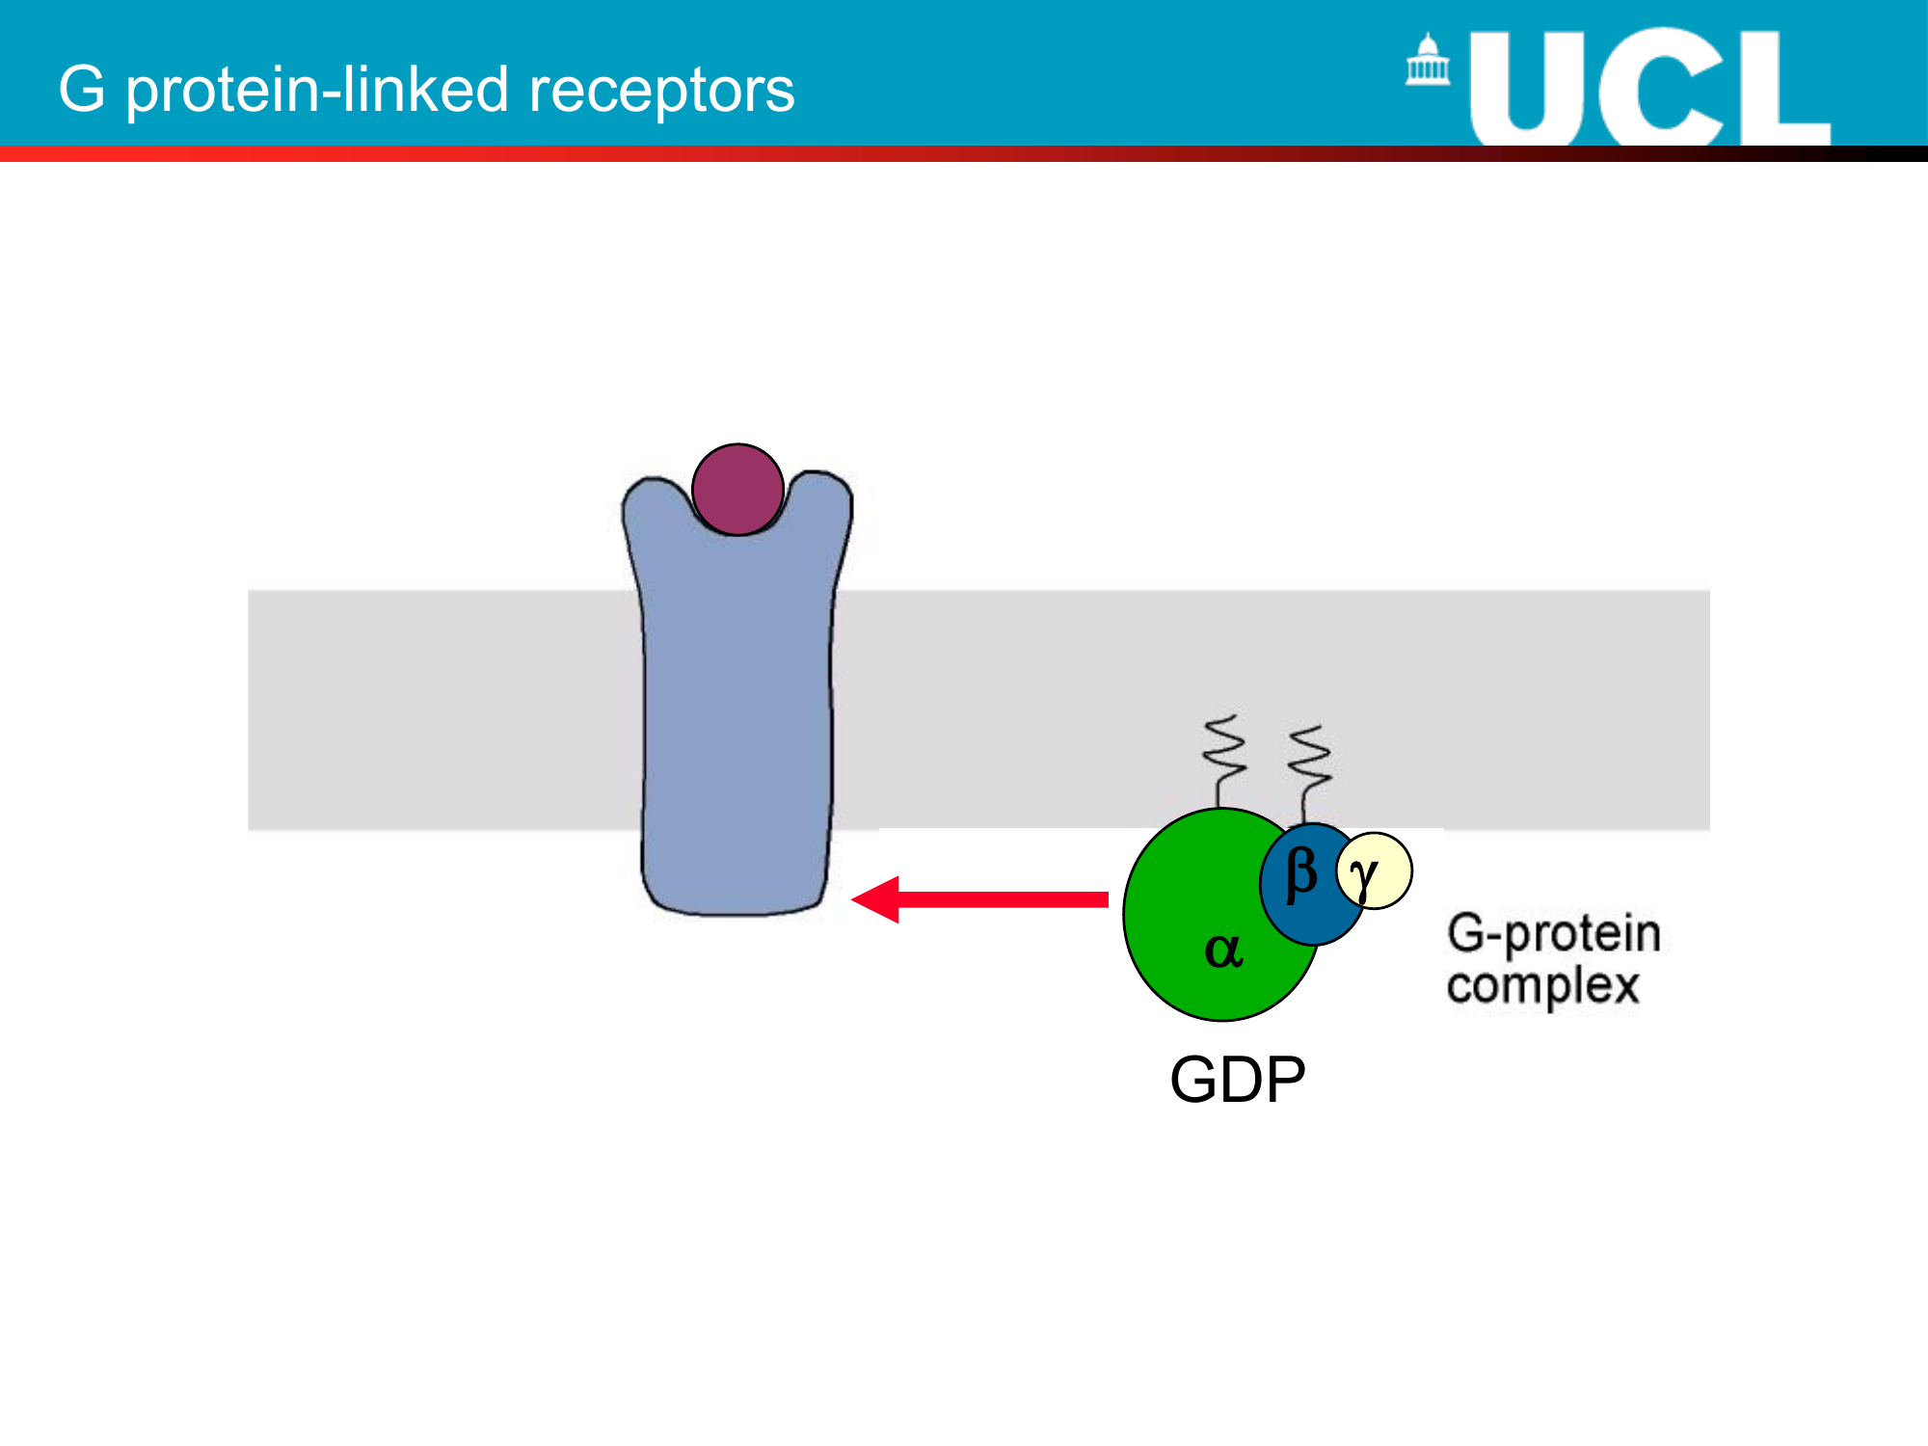

Slide 33
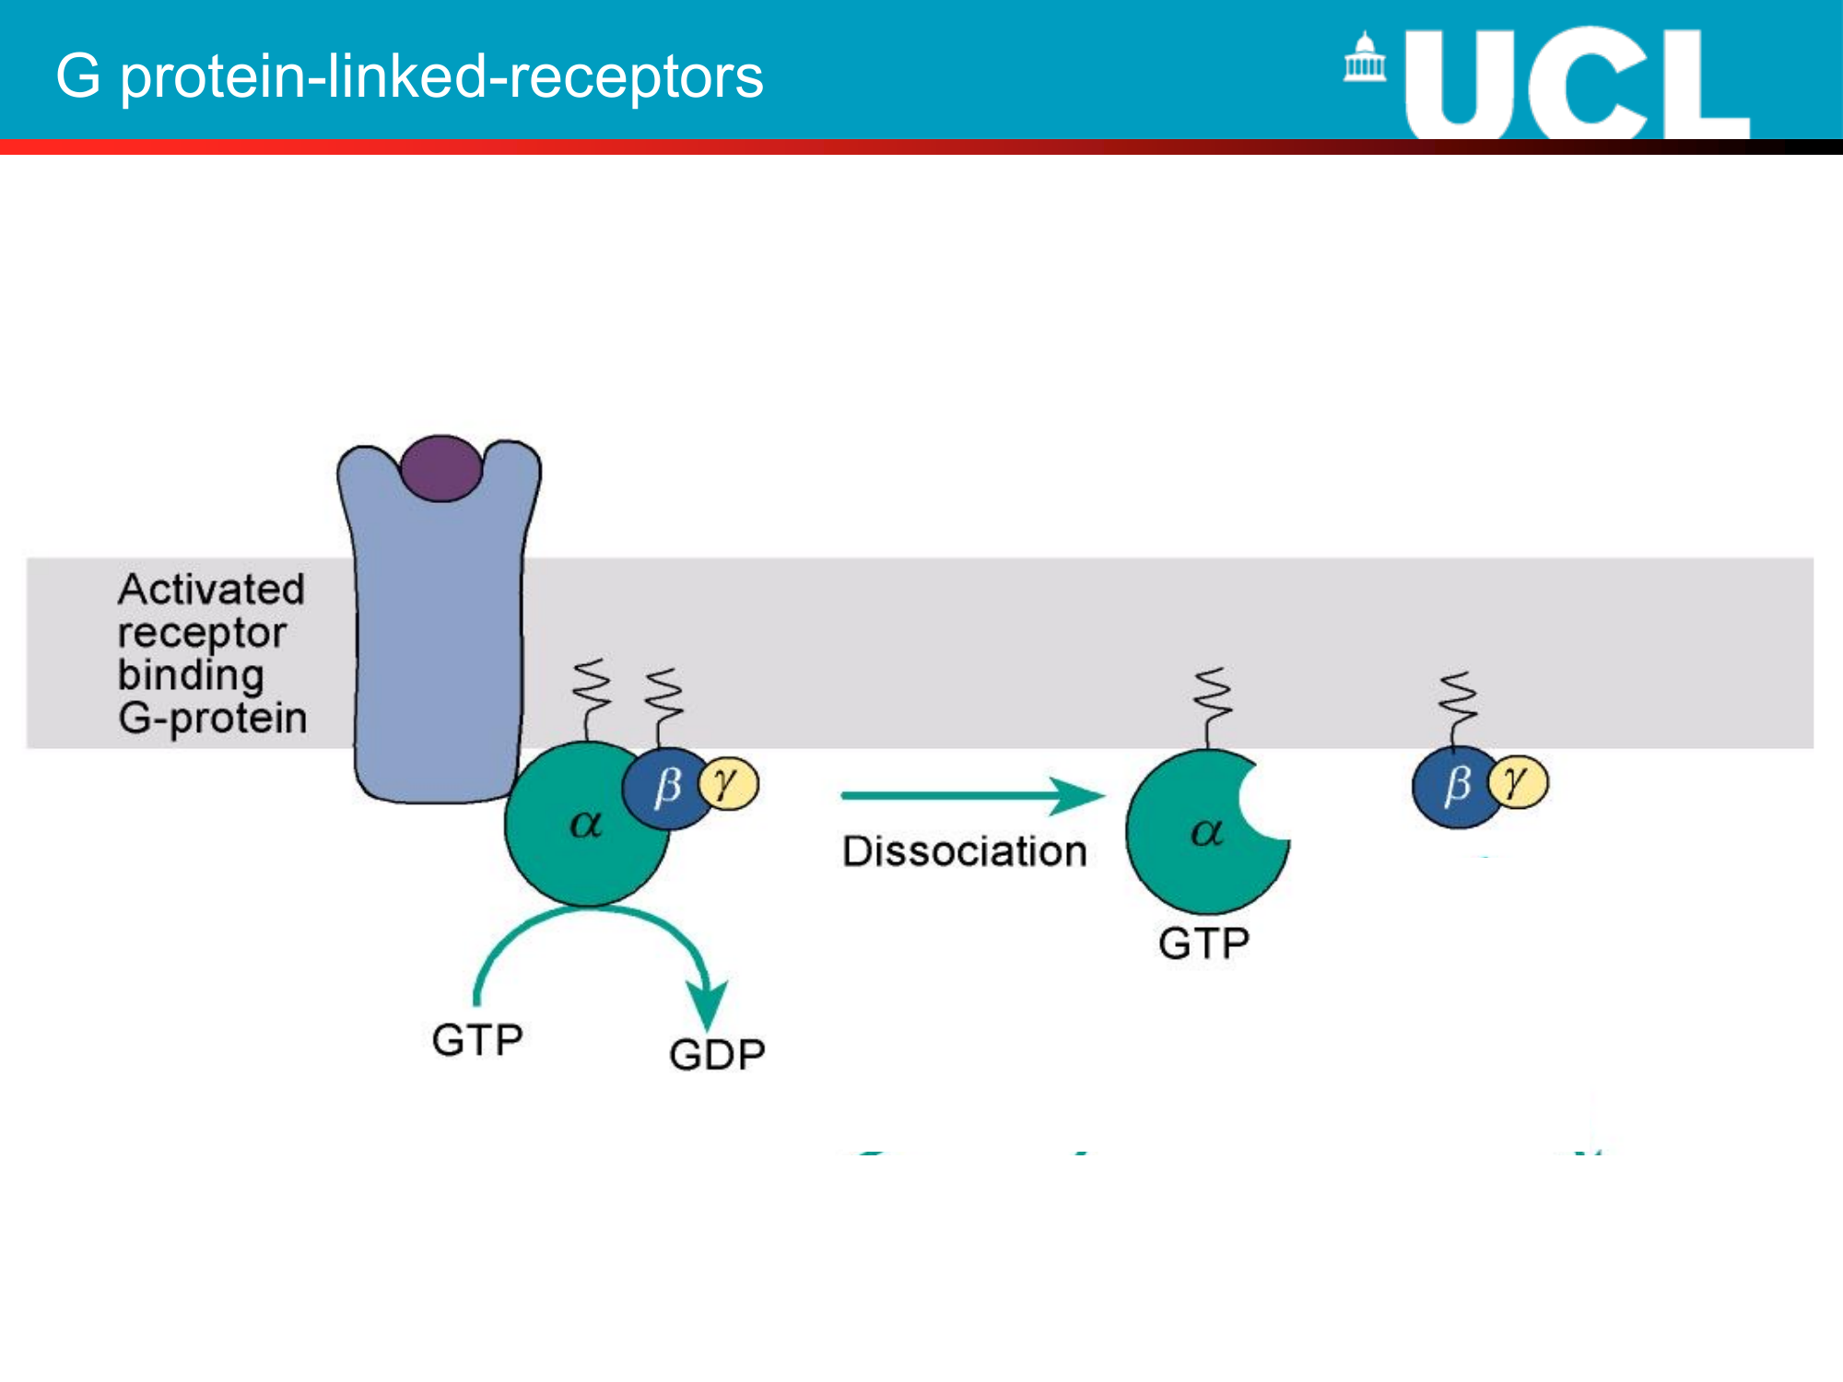

Slide 34
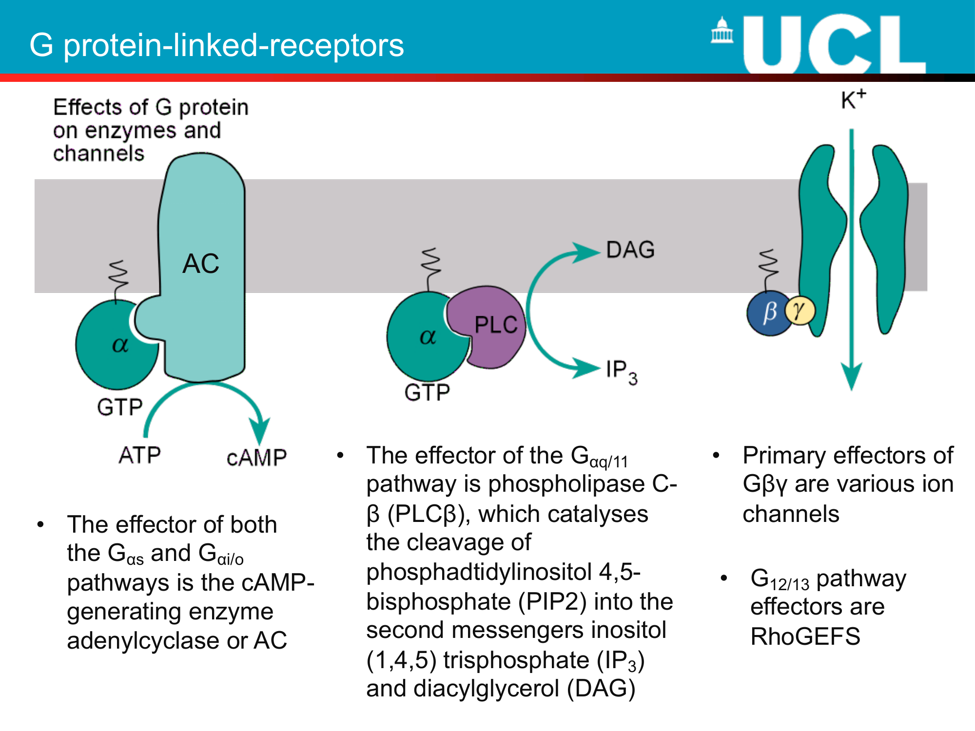

Slide 35
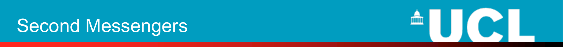
• Many hormones act on G protein linked receptors
• Certain G protein subunits activate intracellular enzymes that synthesise intracellular signalling molecules, which then act on specific intracellular targets
• This intracellular signalling molecule is called a second messenger - the original hormone is the first messenger

Slide 36
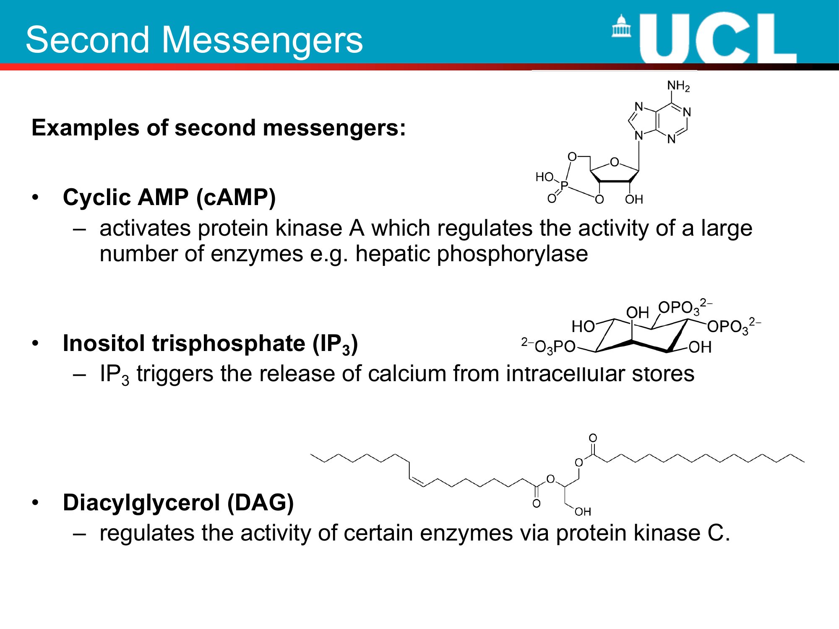

Slide 37
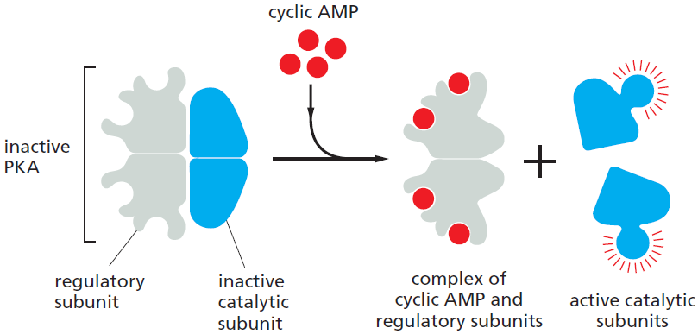
The activation of cyclic- AMP-dependent protein kinase (PKA).

Slide 38
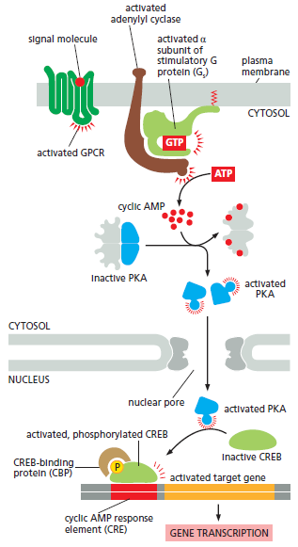
How a rise in intracellular cyclic AMP concentration can alter gene transcription.

Slide 39
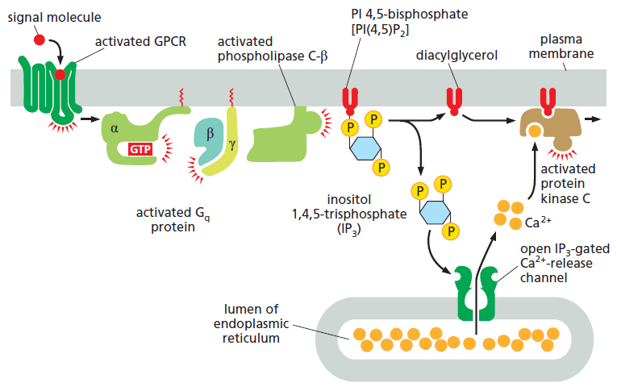
How GPCRs increase cytosolic Ca2+ and activate protein kinase C.

Slide 40
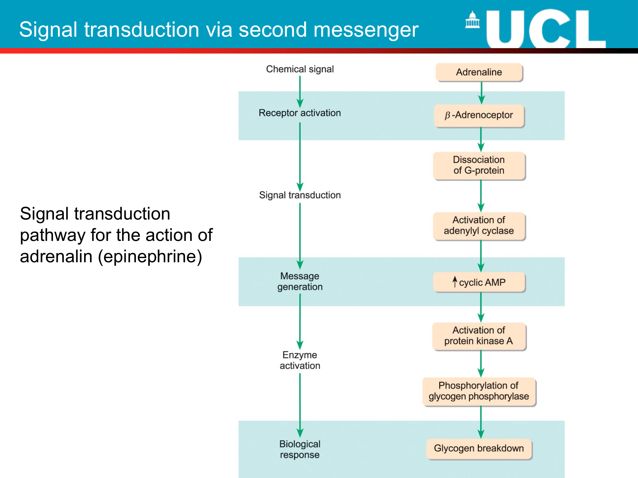

Slide 41
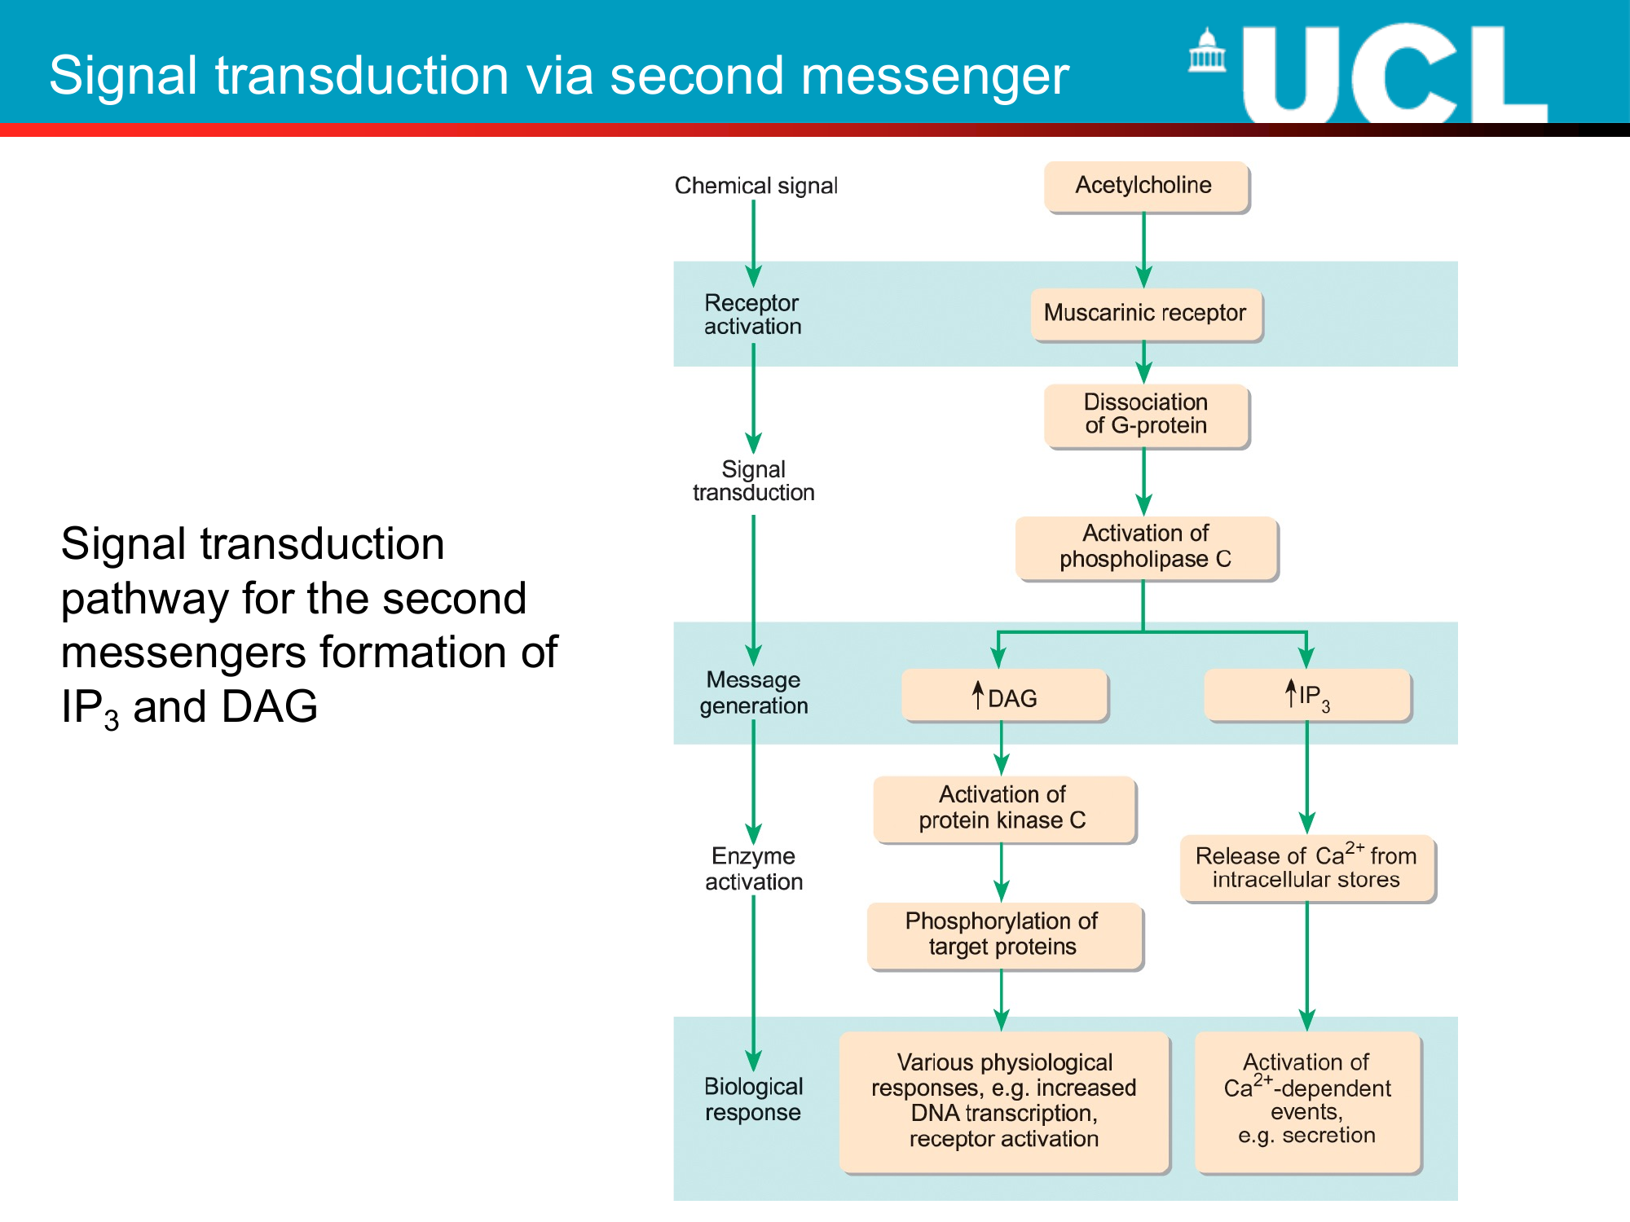

Slide 42
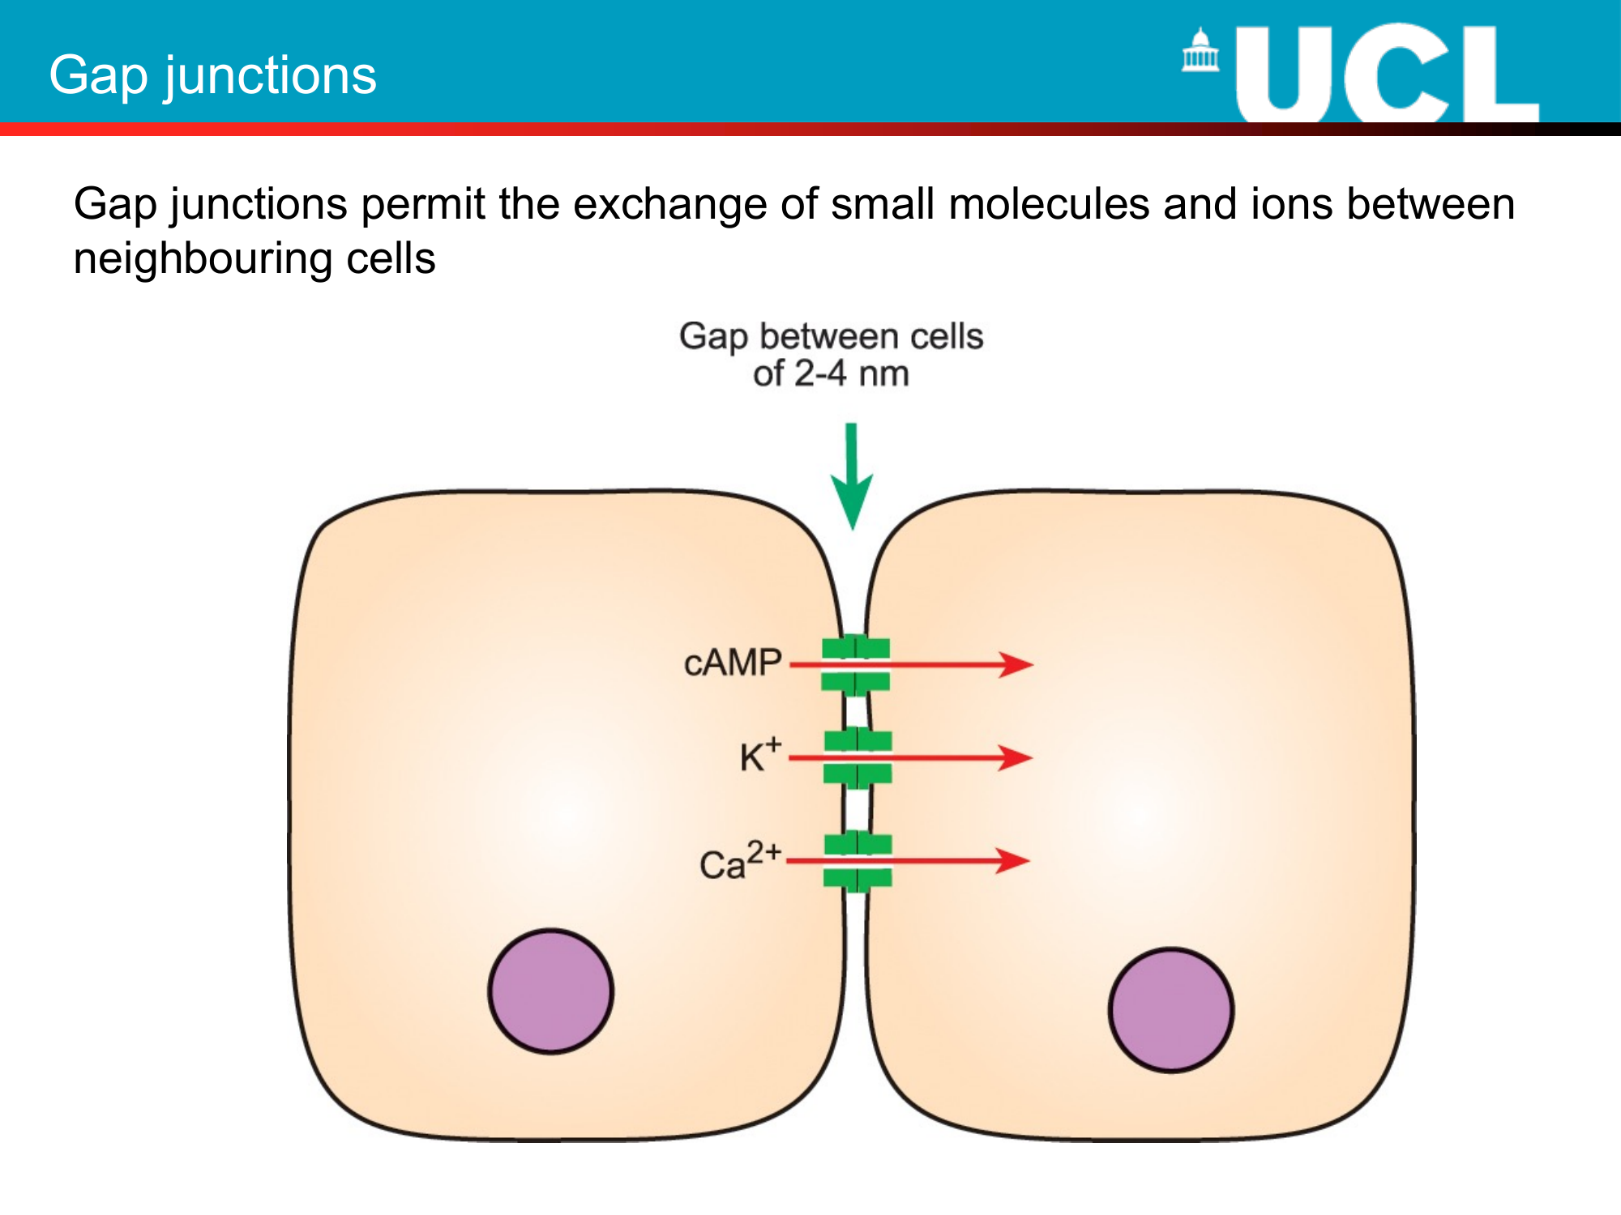

Slide 43
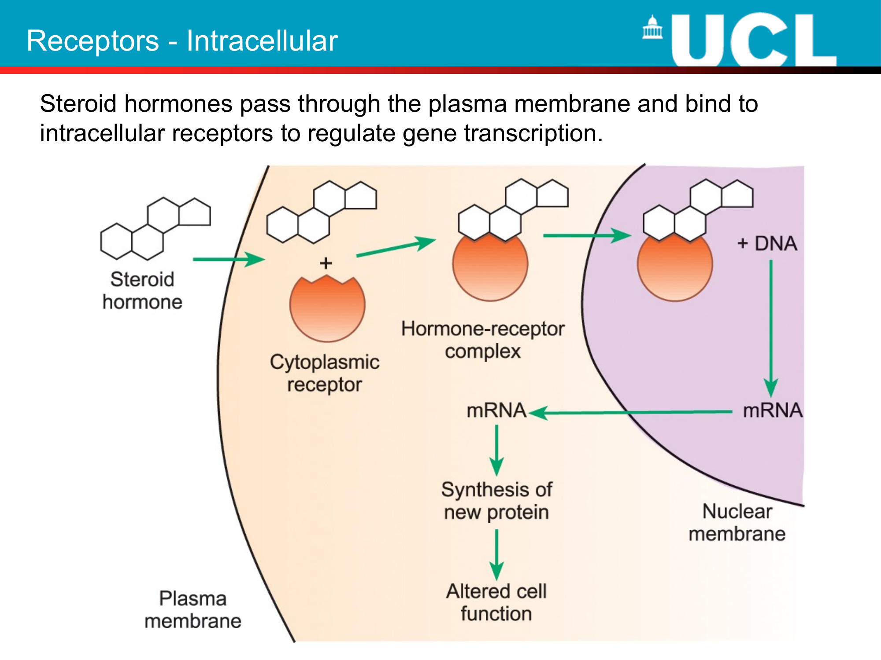

Slide 44
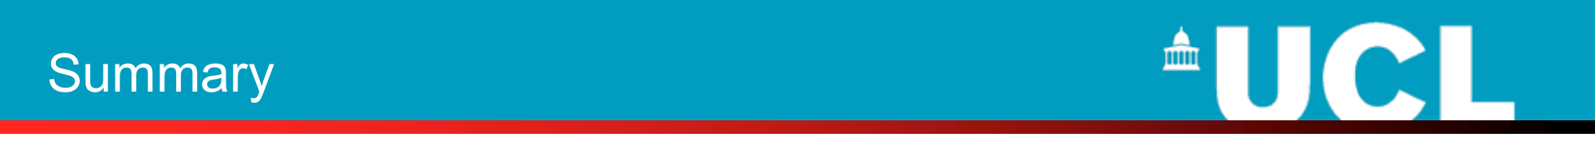
• Cells co-ordinate their activities by sending and receiving chemical signals of various kinds
• Paracrine and autocrine signals are localised
• Endocrine signals act on many different cell types, tissues and organs, often quite distance to their source
• Synaptic signalling is over a very short distance to control specific target cells
• Chemical signals are detected by specific receptor molecules.
• Receptors alter the activity of a cell by:
o Modulating the activity of an ion channel
o Modulating the activity of an enzyme
o Altering gene expression

